Slide 1
University of Warwick Summer School
MULTIPURPOSE POWERPOINT PRESENTATION
Finance in the 21st Century
Fatih Kansoy

Slide 2
Bitcoin
2
The First Cryptocurrency. Understanding the birth of Bitcoin , its history, the first message, and the problem it solved
What is Cryptocurrency
1
A brief explanation of the concept, highlighting its decentralized nature, digital form, and reliance on cryptographic security.
OUTLINE

Slide 3
Blockchain and Finance
4
Blockchain reduces dependency on central financial institutions for transactions, increasing peer-to-peer transactions and democratizing finance..
3
Is Bitcoin Money or Bubble?
To be considered money, Bitcoin needs to function as a medium of exchange, a store of value, and a unit of account

Slide 4
Central Banking
6
Central banks control monetary policy, influencing interest rates and money supply, which directly affect inflation, economic growth, and the stability of financial markets. They also act as lenders of last resort during financial crises, maintaining confidence and functionality in the banking system, which is crucial for a healthy economy.
$
$
5
Central Bank Digital Currencies
Central banks control monetary policy, influencing interest rates and money supply, which directly affect inflation, economic growth, and the stability of financial markets. They also act as lenders of last resort during financial crises, maintaining confidence and functionality in the banking system, which is crucial for a healthy economy.

Slide 5
Climate Crisis and Finance
8
Finance plays a pivotal role in addressing climate crises by redirecting investments towards sustainable and environmentally friendly projects, also known as green finance. Additionally, Environmental, Social, and Governance (ESG) factors in investment decisions can drive corporate behaviour towards sustainability, helping mitigate climate risks and promote a greener economy.
ESG
7
Financial Markets
Understanding their workings helps individuals make informed decisions about savings, investments, and retirement planning, which are crucial for financial security.

Slide 6

Machine and Finance
10
Algorithm allows high-speed, automated trading decisions that can capitalize on market trends and anomalies faster than humans. Machine learning helps refine these algorithms over time to improve their performance, accuracy, and adaptability to market changes..
9
Big Data and Finance
Big data enables detailed financial analysis and predictive modelling, improving decision-making, risk management, and market predictions in finance. It also helps in personalizing financial services, detecting fraudulent activities, and complying with regulatory requirements more efficiently.

Slide 7
11
Conclusion

Slide 8
Blockchain
Cryptocurrency
Bitcoin

Slide 9

Blockchain
Blockchain is a decentralized, digital ledger system that records and securely stores information across multiple computers, ensuring transparency and immutability. Each block of data is cryptographically linked to the previous one, forming a chain of records. Its design prevents the alteration of existing data, making it a secure and reliable system for recording transactions, such as those in cryptocurrencies like Bitcoin.

Slide 10

Some Examples
1
Healthcare: Patient records can be stored on a blockchain, providing a complete, accurate, and tamper-proof medical history. It can also be used to track the spread of diseases or manage pharmaceutical supply chains.
2
Voting Systems: Blockchain technology can be used to create tamper-proof voting systems, enhancing transparency and reducing fraud in electoral processes.
3
Identity Verification: Blockchain can provide a secure and decentralized way of managing digital identities, enhancing privacy, and reducing the risk of identity theft.
4
Real Estate: Blockchain can streamline the real estate market by simplifying the process of buying, selling, or renting properties. It can facilitate smart contracts, reduce fraud, and enable a more transparent and efficient process.
5
Finance: Blockchain technology can facilitate faster, more secure payments, and money transfers. It can also enable decentralized finance (DeFi) applications, including lending platforms and prediction markets.

Slide 11

Cryptocurrency
Cryptocurrency is a digital or virtual form of currency that uses cryptography for security, making it difficult to counterfeit. It operates on decentralized systems called blockchains, enabling peer-to-peer transactions independent of centralized authorities like banks or governments.

Slide 12
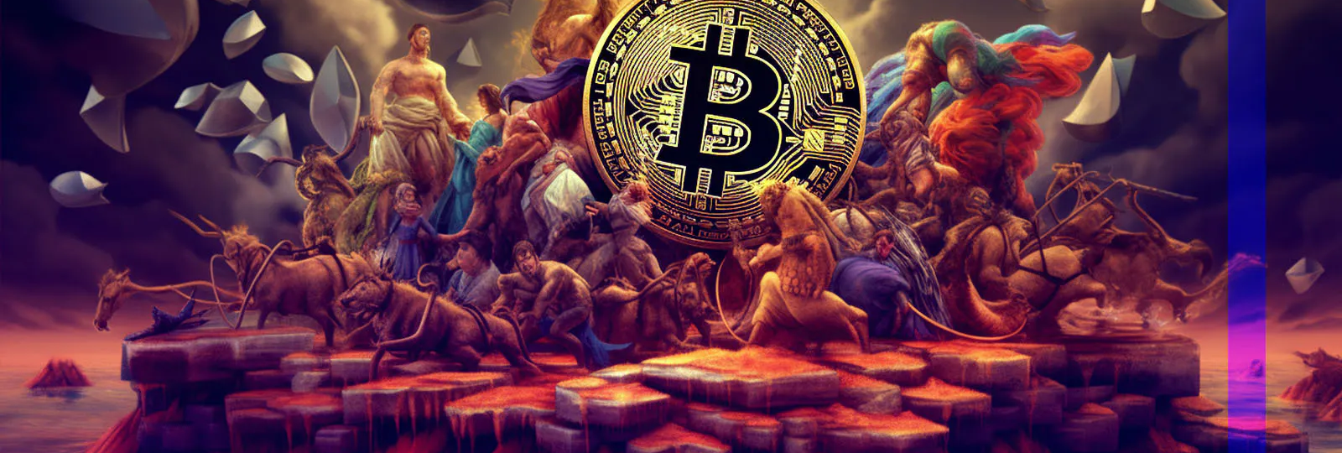
Bitcoin
Bitcoin is the first decentralized cryptocurrency, created in 2009 by an unknown person using the name Satoshi Nakamoto. It operates on a peer-to-peer network where users can send and receive bitcoins (often denoted as BTC), without the need for intermediaries, leveraging blockchain technology to ensure transaction integrity and security.

Slide 13

Understanding Blockchain
Technology that guarantees security and transparency
Blockchain is a technology that ensures robust security and unparalleled transparency. A transformative technology that has the power to revolutionize multiple sectors beyond finance, from healthcare to supply chain management.
A chain of blocks, each containing transaction data
Not just the transaction's details, but more such as sender and receiver, but also incorporates timestamps and unique identifiers. This granular level of detail enhances the system's transparency, allowing each transaction's path to be traceable, auditable, and unquestionably clear.
Each block is linked to the previous one via cryptographic hash"
Link via a cryptographic hash - a string of numbers and letters produced by a complex mathematical algorithm. This hash serves as a kind of digital fingerprint, unique to each block. This feature is what secures the blockchain from tampering, making it immutable and exceptionally secure.
Notes:
This section of the presentation is focused on helping us understand what cryptocurrency is. We will explore the basic principles that define it and make it unique as a form of currency.

Slide 14
Understanding Cryptocurrency
Operates independently of a central bank
Operates independently of a central bank: Cryptocurrencies aren't issued or regulated by any centralized authority. This makes them immune to government interference and manipulation, providing a level of financial freedom and anonymity not possible with traditional currencies.
Cryptographic security
They use cryptographic security. This means that transactions and control over the creation of new units are secured using complex mathematical problems, making them extremely secure and almost impossible to hack or counterfeit.
Notes:
This section of the presentation is focused on helping us understand what cryptocurrency is. We will explore the basic principles that define it and make it unique as a form of currency.

Slide 15

Understanding Bitcoin
Created in 2009 by Satoshi Nakamoto
Born out of the ashes of the 2008 financial crisis. This elusive creator or creators remained anonymous, but their innovation has left an indelible mark on the world.
What was the main message?
The first block, or the 'genesis block' as it is called, contained a text message from Nakamoto: "The Times 03/Jan/2009 Chancellor on brink of second bailout for banks," pointing to Bitcoin's founding in the midst of a financial crisis.
What does the message say?
Nakamoto's reference to the events of the time in the genesis block was a clear commentary on the state of the traditional financial system. Nakamoto's proposed an alternative system where a new, more equitable form of money could offer a potential solution.
Notes:
This section of the presentation is focused on helping us understand what cryptocurrency is. We will explore the basic principles that define it and make it unique as a form of currency.

Slide 16
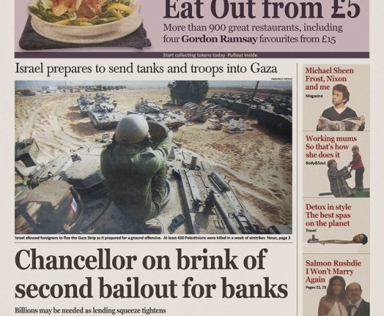
Notes:
This section of the presentation is focused on helping us understand what cryptocurrency is. We will explore the basic principles that define it and make it unique as a form of currency.

Slide 17
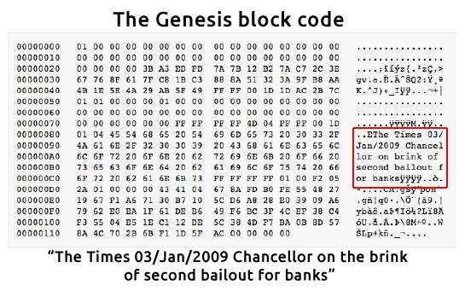
Notes:
This section of the presentation is focused on helping us understand what cryptocurrency is. We will explore the basic principles that define it and make it unique as a form of currency.

Slide 18
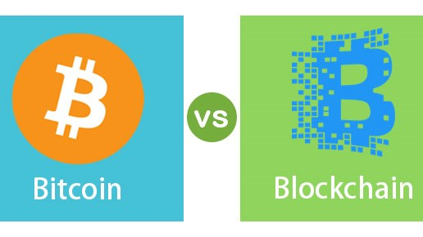
Notes:
This section of the presentation is focused on helping us understand what cryptocurrency is. We will explore the basic principles that define it and make it unique as a form of currency.

Slide 19

Understanding Bitcoin
Bitcoin's fixed supply and its implications on its value.
Unlike fiat currencies, Bitcoin has a fixed supply. The maximum number of Bitcoins that can ever exist is 21 million. This limit creates a scarcity element, similar to that of gold or other precious metals.
The Role of Miners: Understanding the Bitcoin mining process.
Miners validate new transactions and record them on the global ledger. For this service, miners are rewarded with newly minted Bitcoin, in a process known as block rewards. However, this process consumes significant computational resources and energy.
Bitcoin's Volatility
Bitcoin is generally more volatile than traditional asset classes like the S&P 500 or other national stock markets. The price of Bitcoin can fluctuate significantly in a very short time, making it possible for investors to experience rapid gains or losses.
Notes:
This section of the presentation is focused on helping us understand what cryptocurrency is. We will explore the basic principles that define it and make it unique as a form of currency.

Slide 20

Is Bitcoin Money?
Bitcoin Is A Cryptocurrency, But Is It Money?
What
is
Money?

Slide 21

What is Money
1
Medium of Exchange
Money acts as an intermediary in transactions, allowing people to exchange goods and services without the need for barter (direct exchange of one good for another).
2
Unit of Account
Money provides a common unit of measurement for pricing goods and services. It enables easy comparison of the value of different products and allows for a standardized way of expressing prices, wages, and other financial transactions.
3
Store of Value
Money can be held and saved to be used in the future. It serves as a store of value because people can use it to preserve purchasing power over time.

Slide 22
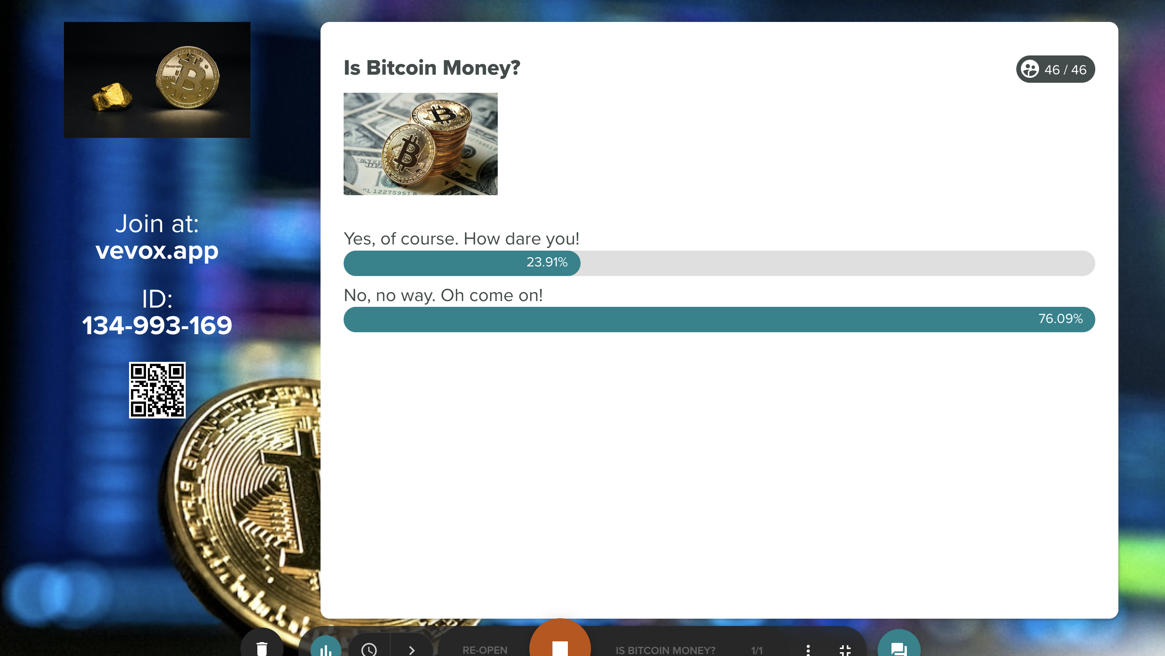
Notes:
This section of the presentation is focused on helping us understand what cryptocurrency is. We will explore the basic principles that define it and make it unique as a form of currency.

Slide 23
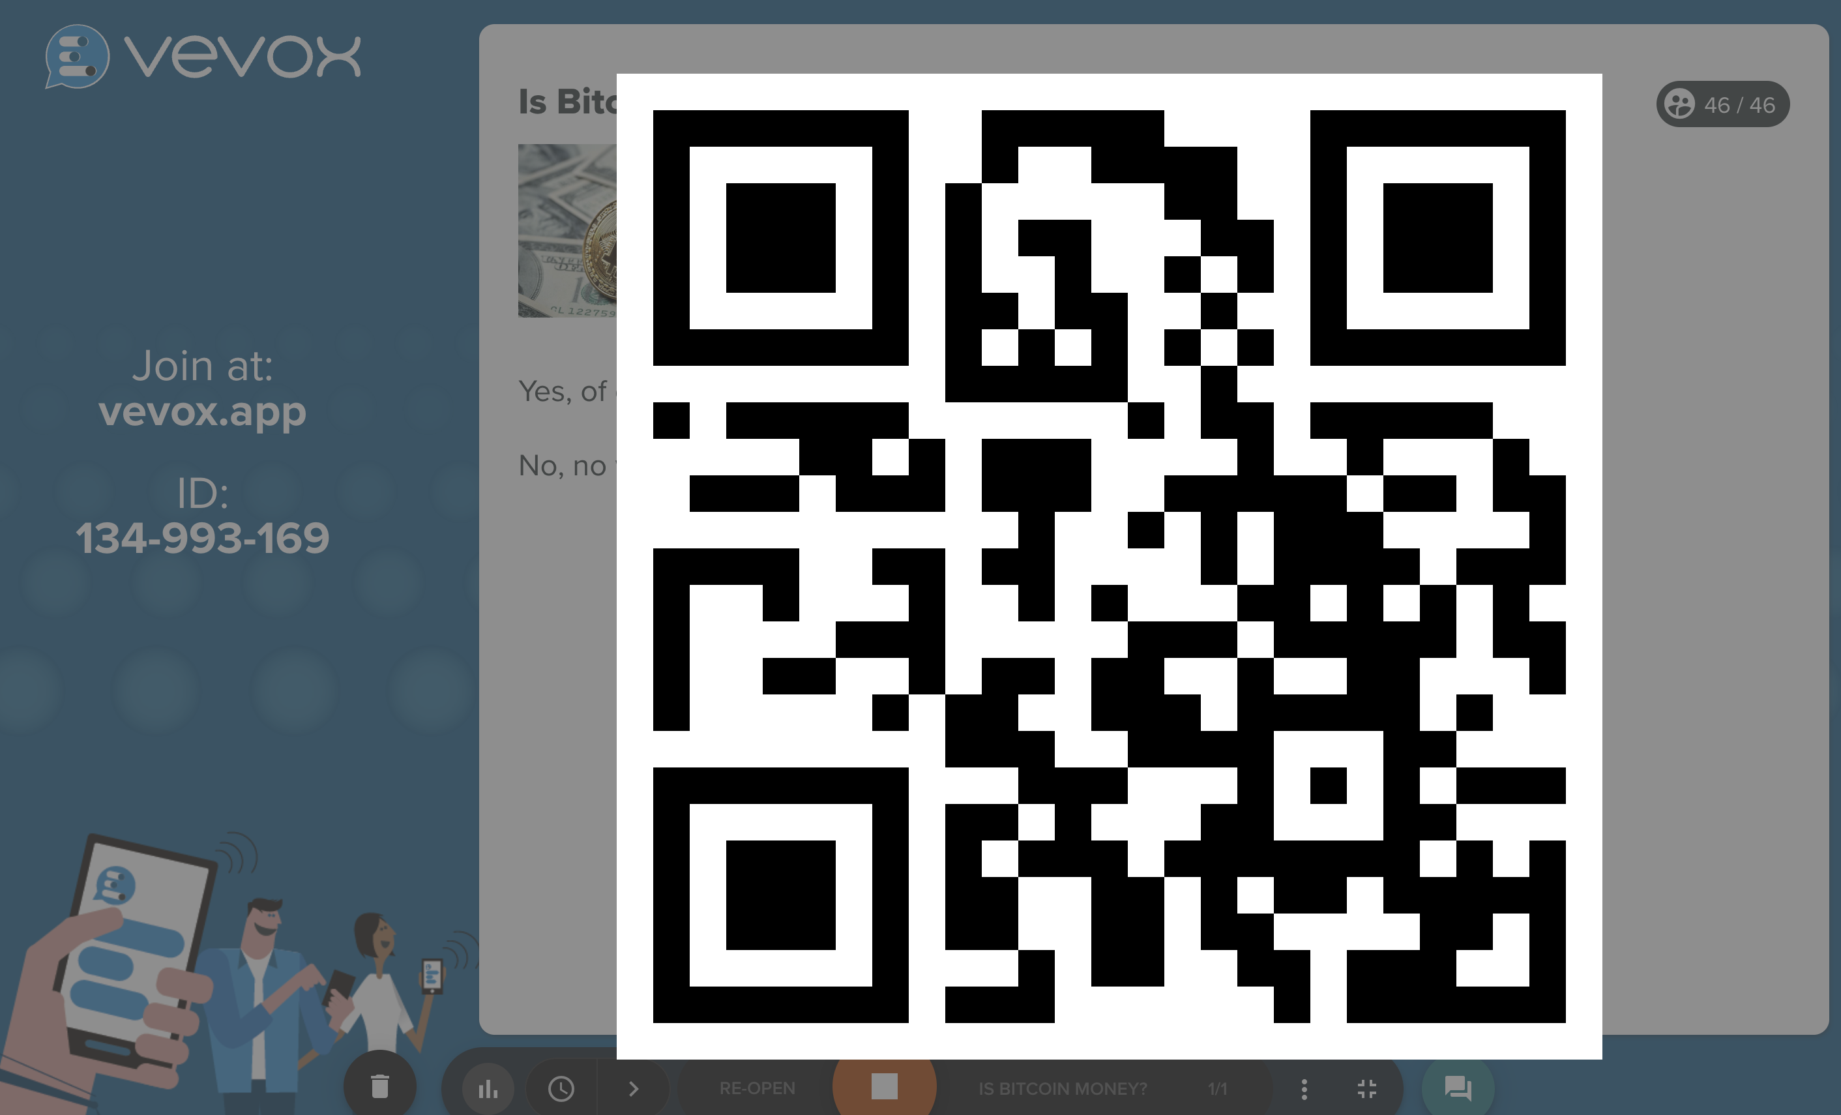
Notes:
This section of the presentation is focused on helping us understand what cryptocurrency is. We will explore the basic principles that define it and make it unique as a form of currency.

Slide 24
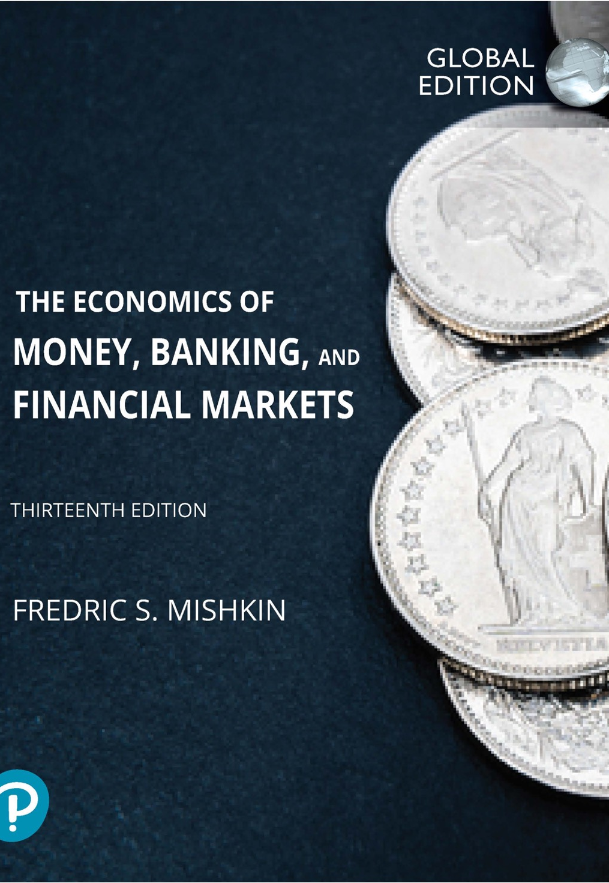
Textbook:
1
Medium of Exchange: YES
2
Unit of Account: NO
“The price of Bitcoin has been extremely volatile, with its volatility estimated to be over seven times that of the price of gold and over eight times that of stock market indexes such as the S&P 500. Not surprisingly, no cryptocurrency has become a unit of account: Almost no one quotes the prices of their products in terms of bitcoins or any other cryptocurrency.
3
Store of Value: NO
In 2011, the price of a Bitcoin fluctuated between 30 cents and $32. It then rose to a peak of $255 on April 10, 2013, only to fall back down to $55 on April 17. On November 30, 2013, the price of a Bitcoin peaked at $1,125, but it fell to around $200 by June 2015, and then took off to a peak value of nearly $20,000 in December 2017. By 2020, it had fallen to a value below $7,000.” The high volatility of the value of the cryptocurrencies means that they do not function well as a store of value

Slide 25
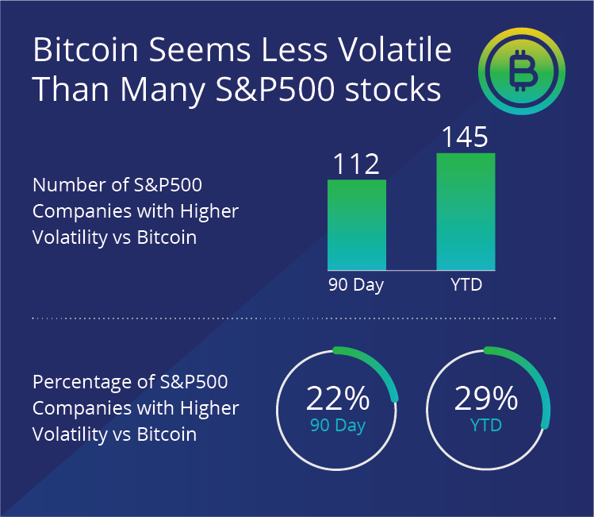
Notes:
This section of the presentation is focused on helping us understand what cryptocurrency is. We will explore the basic principles that define it and make it unique as a form of currency.

Slide 26
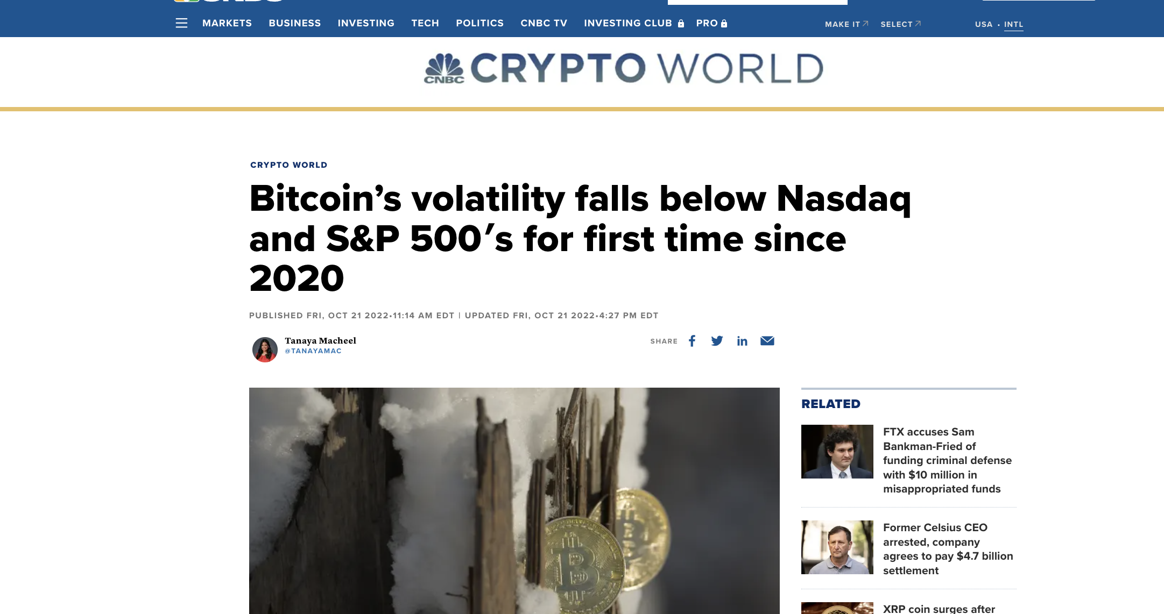
Notes:
This section of the presentation is focused on helping us understand what cryptocurrency is. We will explore the basic principles that define it and make it unique as a form of currency.

Slide 27
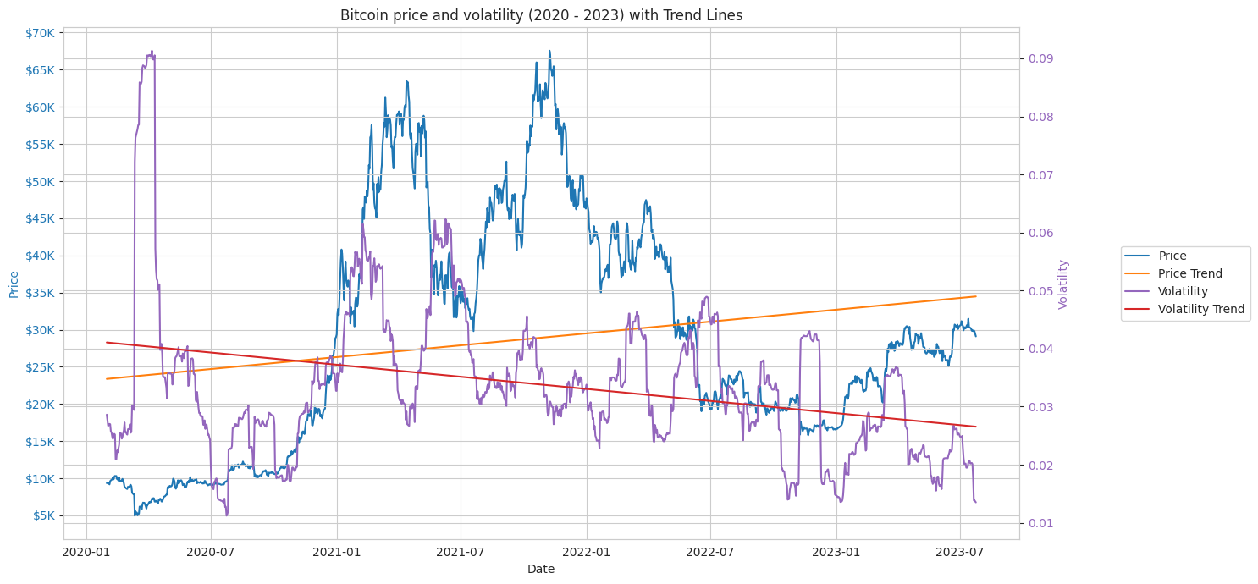
Notes:
This section of the presentation is focused on helping us understand what cryptocurrency is. We will explore the basic principles that define it and make it unique as a form of currency.

Slide 28
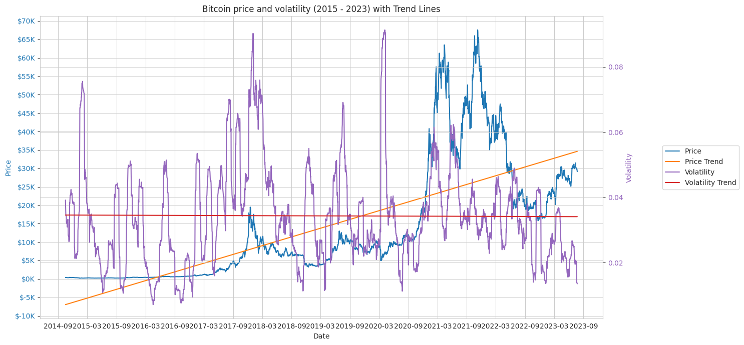
Notes:
This section of the presentation is focused on helping us understand what cryptocurrency is. We will explore the basic principles that define it and make it unique as a form of currency.

Slide 29
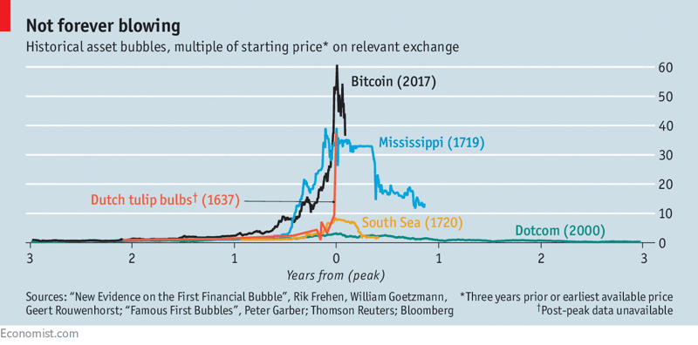
Notes:
This section of the presentation is focused on helping us understand what cryptocurrency is. We will explore the basic principles that define it and make it unique as a form of currency.

Slide 30
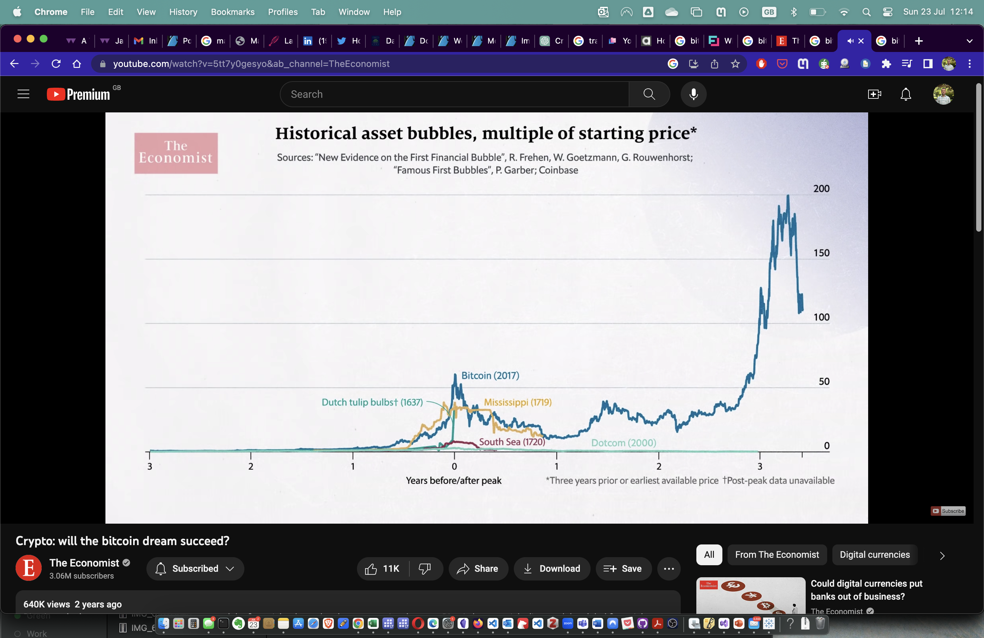

Slide 31
SWOT Analysis of Bitcoin
Strength
S
W
Weakness
O
T
Opportunities
Threats

Slide 32
SWOT Analysis of Bitcoin: Strengths
1
Decentralization
Bitcoin operates on a decentralized network known as blockchain, which makes it resistant to censorship or control by any single entity.
2
Security & Privacy
S
Cryptocurrency can’t be tracked or stolen.
3
Liquidity
Bitcoin is highly liquid and can be easily bought, sold, and converted into cash or other cryptocurrencies.
4
Limited Supply
There will only ever be 21 million bitcoins, which can potentially prevent inflationary issues
5
Global Accessibility
It can be sent anywhere in the world, at any time, irrespective of national borders, making it a globally accessible asset.

Slide 33
SWOT Analysis of Bitcoin: Weakness
1
Volatility
Bitcoin prices are known for being highly volatile, which can make it a risky investment.
2
Lack of Regulatory Oversight
W
While some see this as a strength, the lack of regulation can also be a weakness, as it might lead to fraudulent activities or misuse.
3
Technical Complexity
While strides are being made to simplify it, Bitcoin technology can be complex and intimidating for average users.
4
Environmental Impact
The process of mining Bitcoin requires substantial computational power, leading to significant energy consumption and carbon emissions.
5
Slow transactions
Bitcoin process ten transactions per second while Visa, the credit-card company can do as much as 24,000 per second

Slide 34
SWOT Analysis of Bitcoin: Opportunities
1
Increasing Acceptance
More businesses and countries are starting to accept Bitcoin as a valid form of payment.
O
2
Financial Inclusion
Bitcoin could provide financial services to people who are currently unbanked or underbanked.
3
Safety
Safety from compromising data breaches

Slide 35
SWOT Analysis of Bitcoin: Threats
1
Regulatory Risks
Governments and regulatory bodies around the world might impose restrictive regulations on Bitcoin usage or trading.
T
2
Reputational Risks
Bitcoin has been associated with illicit activities in the past, which could harm its reputation and discourage adoption.
3
Exchange Fraud / Hacks
Since the early days of Bitcoin there have been many bitcoin exchange frauds all around the world and people lost all their bitcoins such as Mt.Gox,, Thodex (Turkey). BitConnect etc

Slide 36
Recap
1
Bitcoin's future is uncertain; it may become a stable asset like gold or burst spectacularly as a bubble.
2
The dream of Bitcoin as a new form of money, independent of governments and central banks, remains elusive.
3
Blockchain technology can be used in a wide variety of sectors and applications beyond just cryptocurrencies like Bitcoin.

Slide 37
The Break!

Slide 38
Central Bank
Digital Currency
(CBDC)

Slide 39
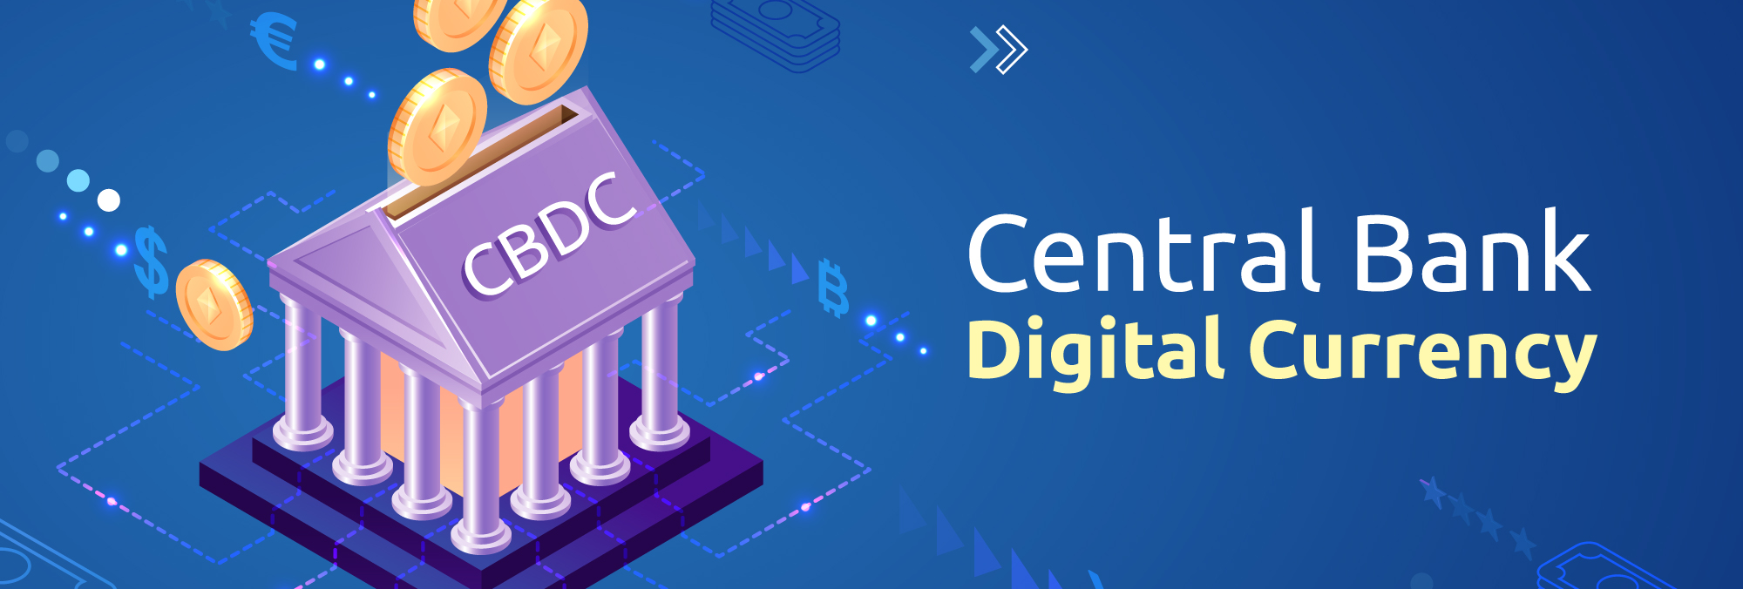
Central Bank Digital Currency
According to Bank of England, Central bank digital currency (CBDC) is money that a country’s central bank can issue. It’s called digital (or electronic) because it isn’t physical money like notes and coins. It is in the form of an amount on a computer or similar device.

Slide 40

CBDC vs CC
1
Central Authority: Cryptocurrencies operate on a decentralized network and do not have any central authority controlling them. In contrast, Central Bank Digital Currencies (CBDCs) are issued and regulated by a country's central bank, making them centralized.
2
Anonymity: Cryptocurrencies, especially ones like Bitcoin, provide a certain degree of anonymity to users, with transactions being pseudonymous. On the other hand, CBDCs are likely to be designed in a way that allows the central bank or the government to trace transactions, thereby reducing anonymity.
3
Stability: Cryptocurrencies are known for their volatility with prices fluctuating dramatically in short periods. CBDCs, being tied to a nation's fiat currency, are expected to have the same value and stability as their physical counterparts.
4
Legal Status: Cryptocurrencies do not have legal tender status in most countries. That means they are not officially recognized as a medium for commercial exchange. However, CBDCs, once implemented, would have legal tender status, making them an officially recognized form of digital currency.
5
Use Case: Cryptocurrencies were initially created as an alternative to traditional currencies and are used for a variety of purposes, including investment, remittances, and sometimes for transactions where anonymity is desired. CBDCs, on the other hand, are envisioned to digitize the existing currency fully, thereby making transactions and money transfers more efficient and inclusive.

Slide 41
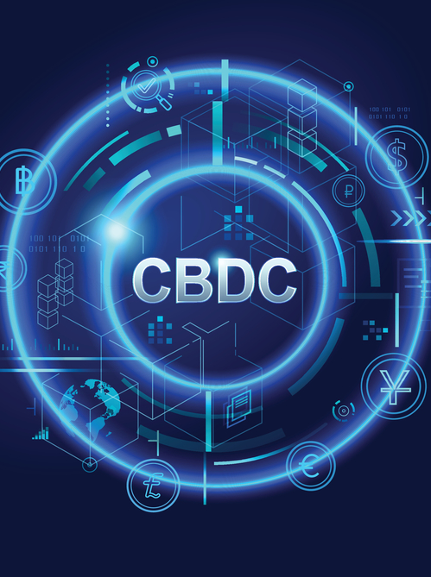
CBDC vs CC
1
Digital Nature: Both cryptocurrencies and CBDCs are fundamentally digital, which means they exist solely in electronic form and are transacted over the internet. This property makes them efficient and accessible from anywhere in the world.
2
Secure Transactions: Cryptocurrencies and CBDCs both leverage cryptographic techniques to secure transactions, ensuring that they are tamper-proof and secure against fraud.
3
Transaction Validation: Both forms of currency use specific mechanisms for transaction validation. In the case of cryptocurrencies, it's typically through a decentralized network of miners. For CBDCs, it would be through a system approved by the central bank, which may or may not be decentralized.
4
Traceability: Each transaction made with cryptocurrencies or CBDCs is recorded on a type of ledger (like a blockchain), providing a transparent history of transactions. This feature can help reduce financial crimes such as money laundering and fraud.
5
Inclusion: Both cryptocurrencies and CBDCs have the potential to increase financial inclusion. They can provide access to financial services for populations that are currently unbanked or underbanked, particularly in areas with high mobile phone penetration but limited access to traditional banking infrastructure.

Slide 42
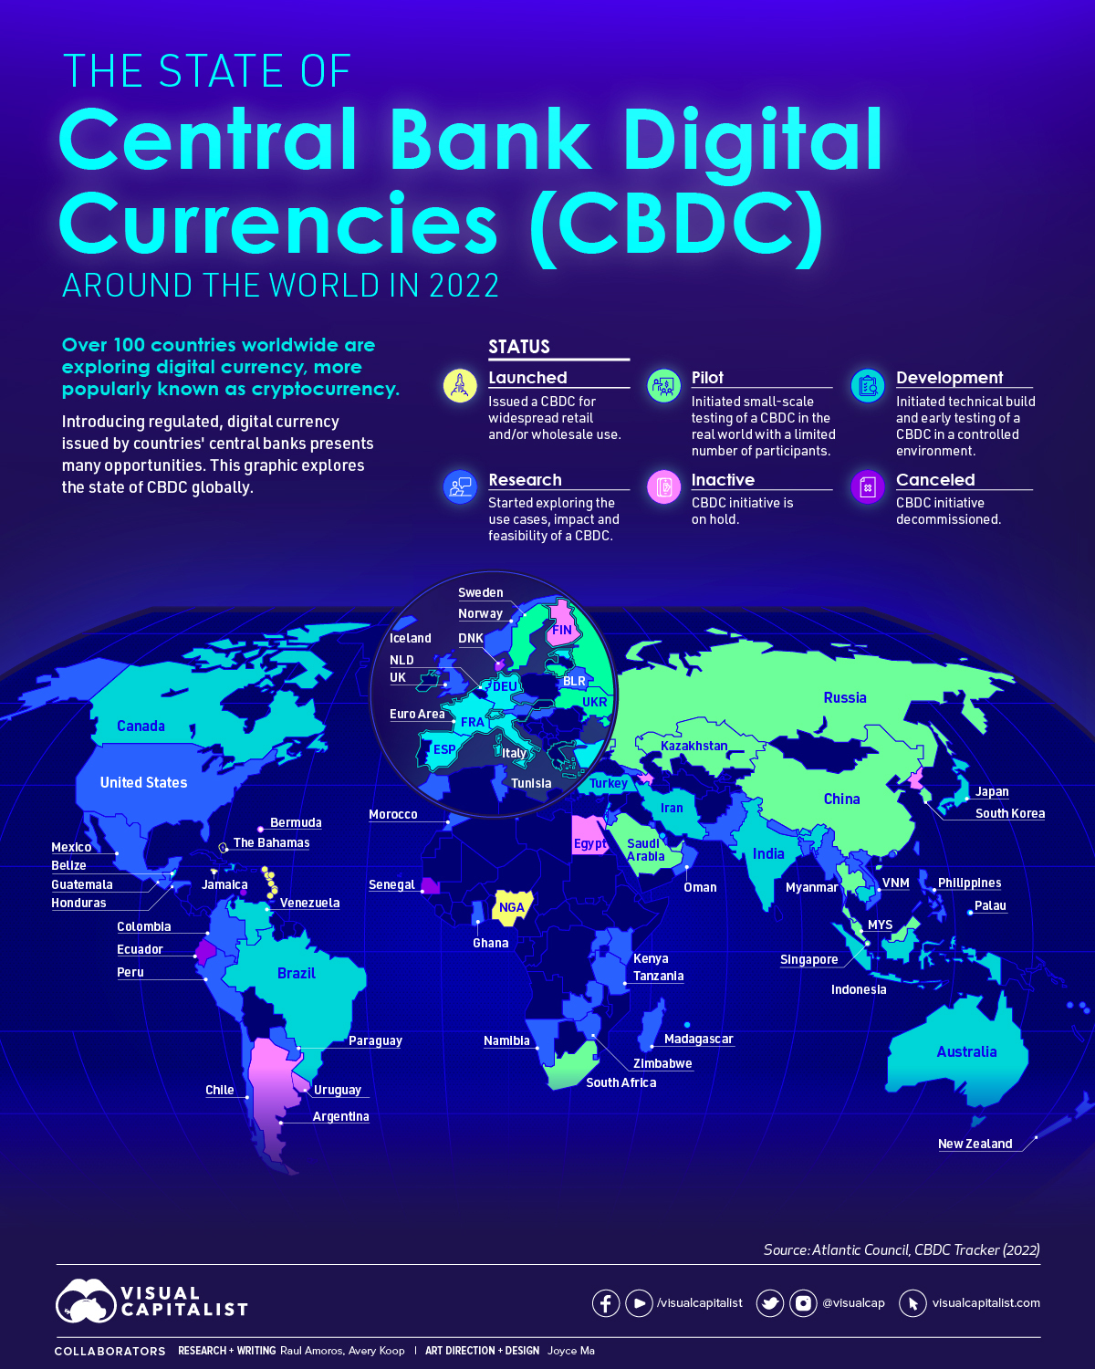
CBDC: An Example
By 2022, 105 countries are currently exploring centralized digital currencies. Together, they represent 95% of global GDP.
Just 9% of countries have launched a digital currency to date. Nigeria, The Bahamas, Jamaica, Sweden, Lithuania, Ukraine…
For example, Nigeria, launched in October 2021 but The eNaira app has accumulated 700,000 downloads as of April 2022. That’s equal to 0.35% of the population, though not all of the downloads are users in Nigeria
Conversely, 33.4 million Nigerians were reported to be trading or owning crypto assets, despite the Central Bank of Nigeria’s attempts to restrict usage

Slide 43
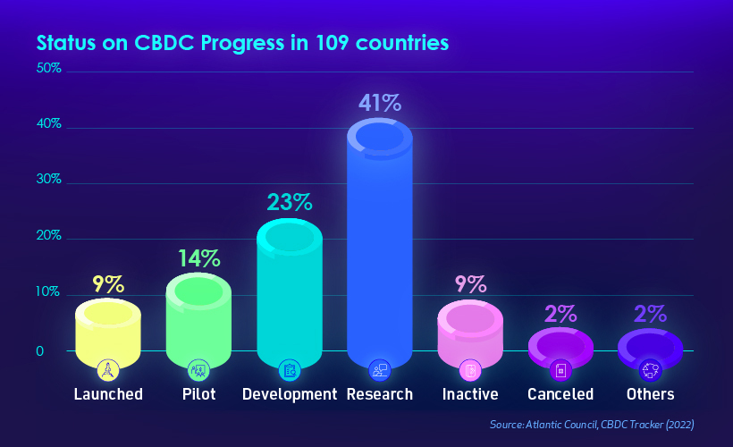

Slide 44
Will Bitcoin
(or Other Currencies)
Become
the Money of the Future?

Slide 45
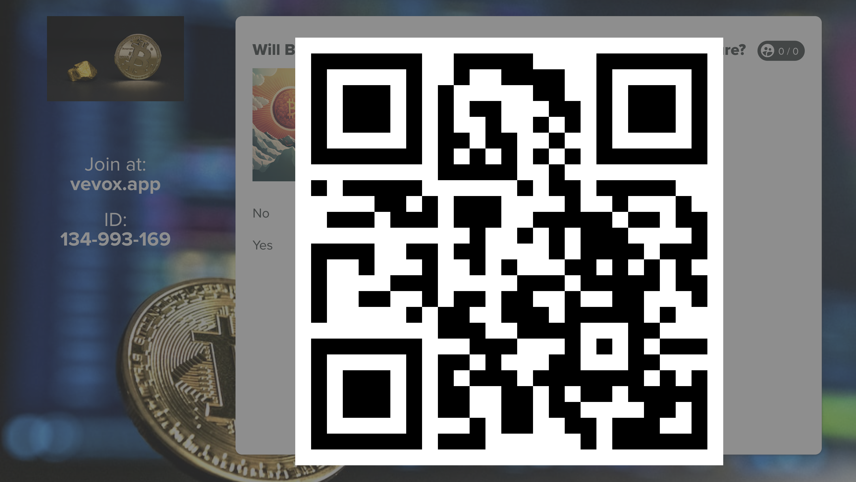

Slide 46
Interest Rates

Slide 47
Tell me
how much time my investment
would take to
double
the current return
(APR: 5%)
?

Slide 48


Who
is
this
guy?

Slide 49

Luca Pacioli – Rule of 72
The rule of 72 is a simple method to determine the amount of time investment would take to double, given a fixed annual interest rate. To use the rule of 72, divide 72 by the annual rate of return.

Slide 50

Why Interest Rates Matter?
Interest rates are among the most closely watched variables in the economy.
Their movements are reported almost daily by the news media because they directly affect our everyday lives and have important consequences for the health of the economy.
They influence personal decisions such as whether to consume or save, whether to buy a house, and whether to purchase bonds or put funds into a savings account.
Interest rates also affect the economic decisions of businesses and households, such as whether to use their funds to invest in new equipment for factories or to save rather than spend their money.

Slide 51

Congratulations! You Won the 20 million Dollar
You will get a payment of 1 million dollar every year for the next 20 years.
You get 10 million dollars right now! (Interest rate is 10%)

Slide 52
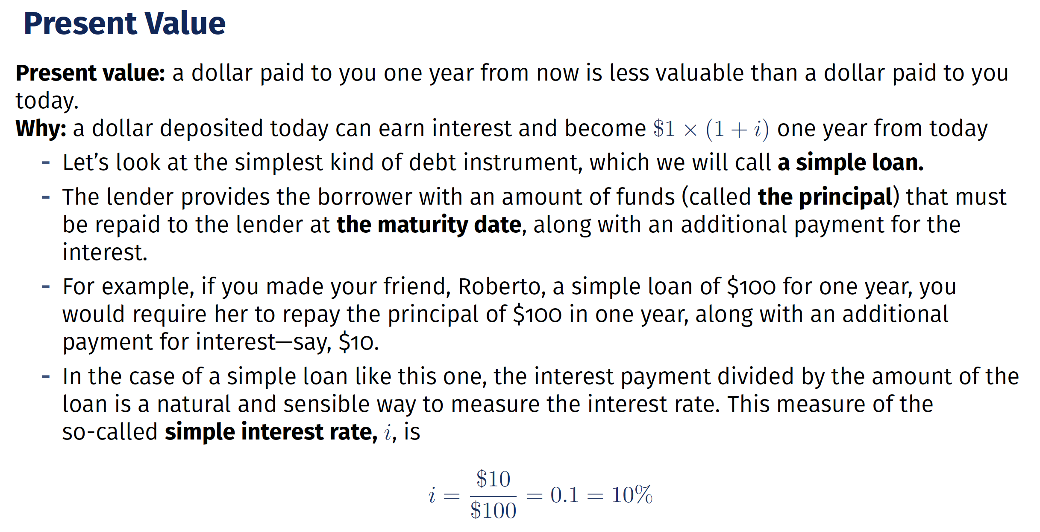

Slide 53
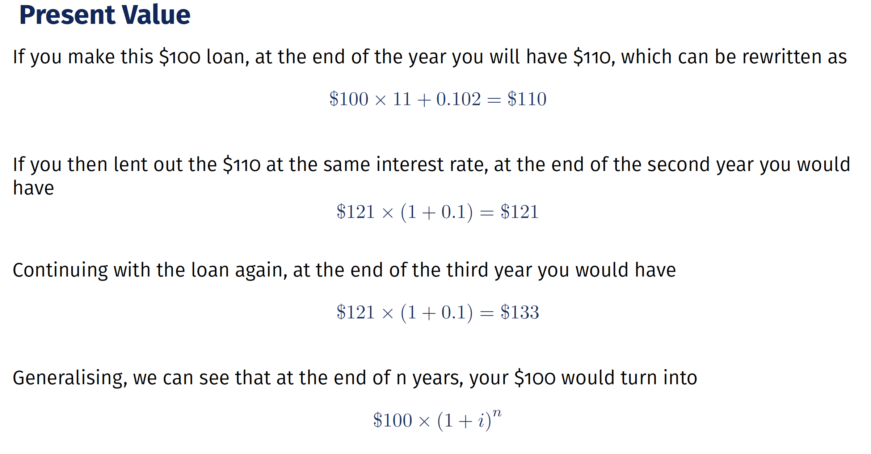

Slide 54
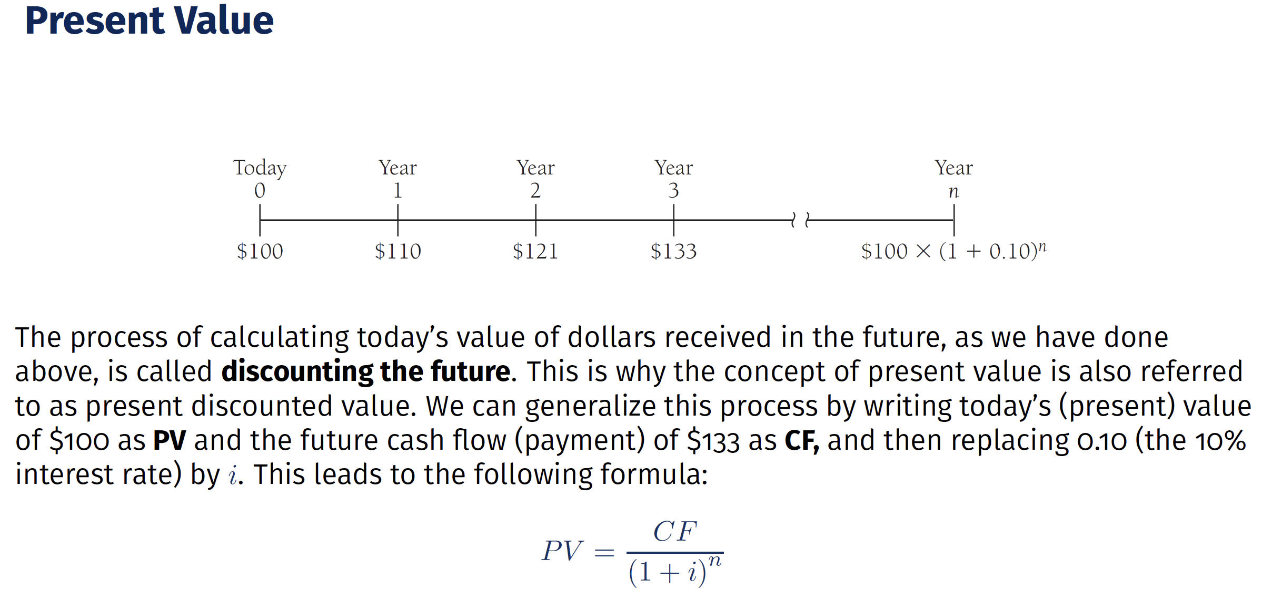

Slide 55
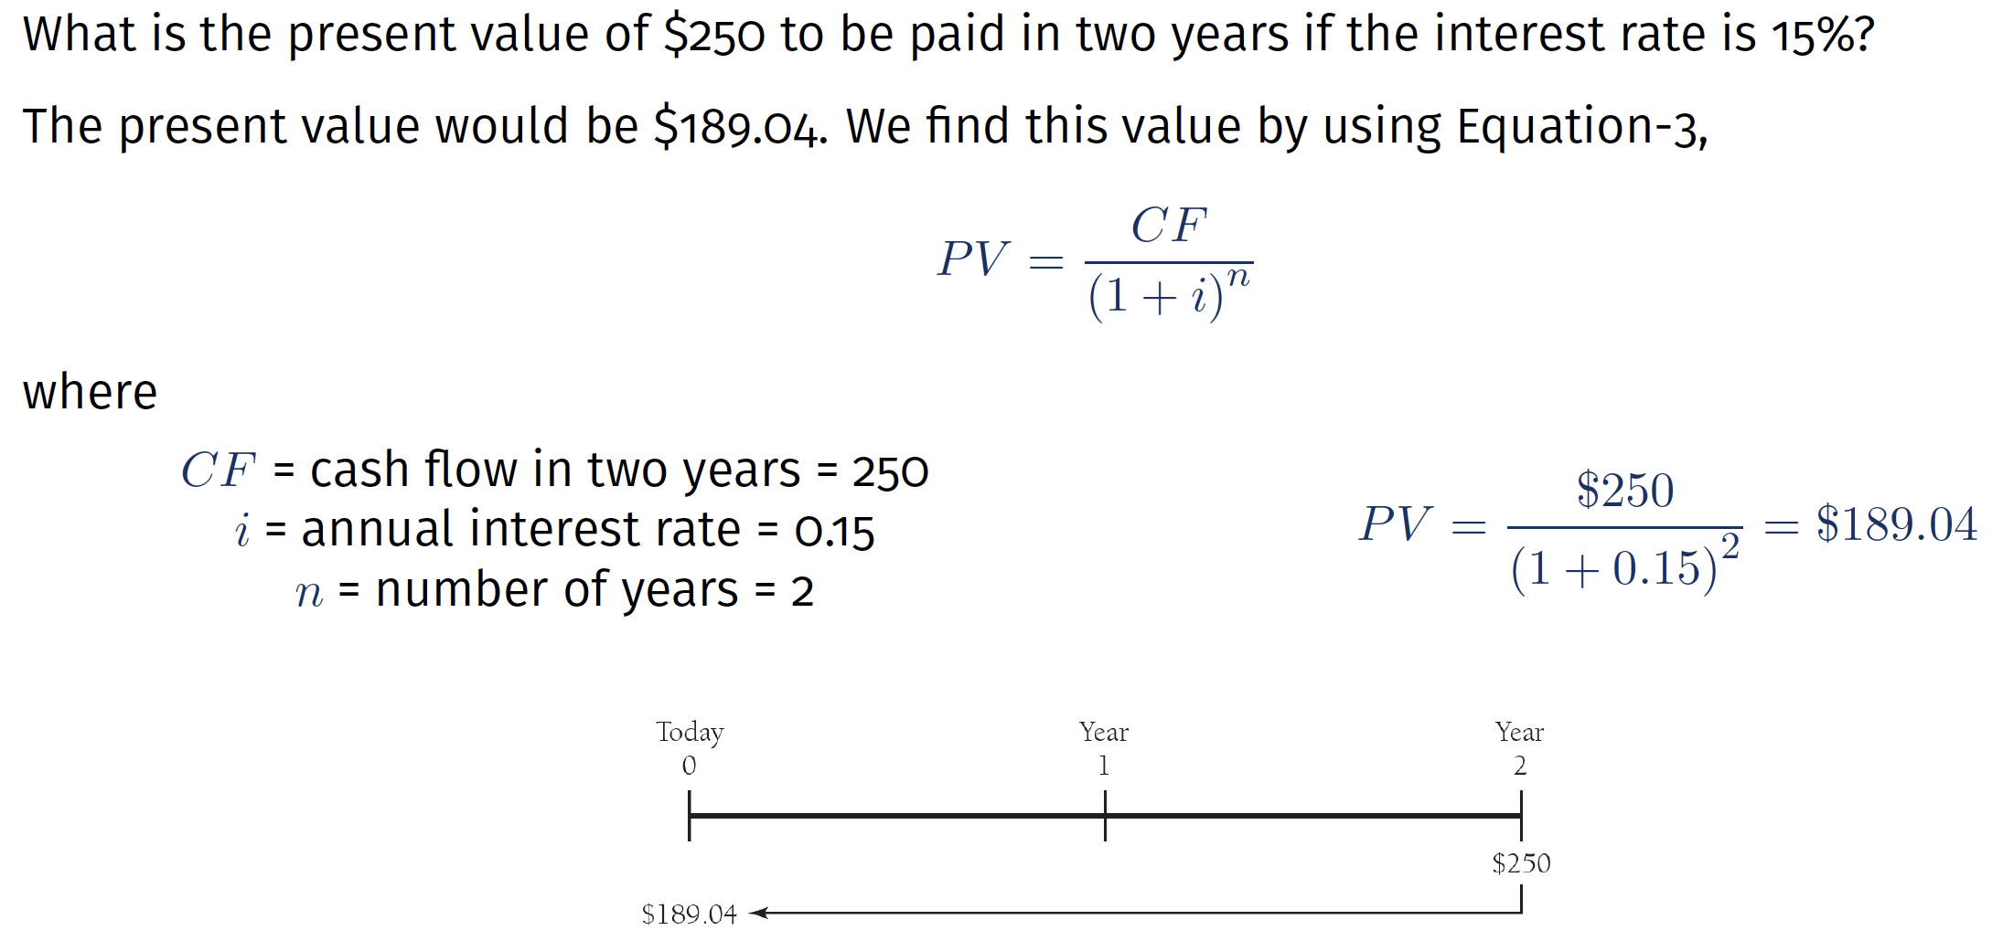

Slide 56
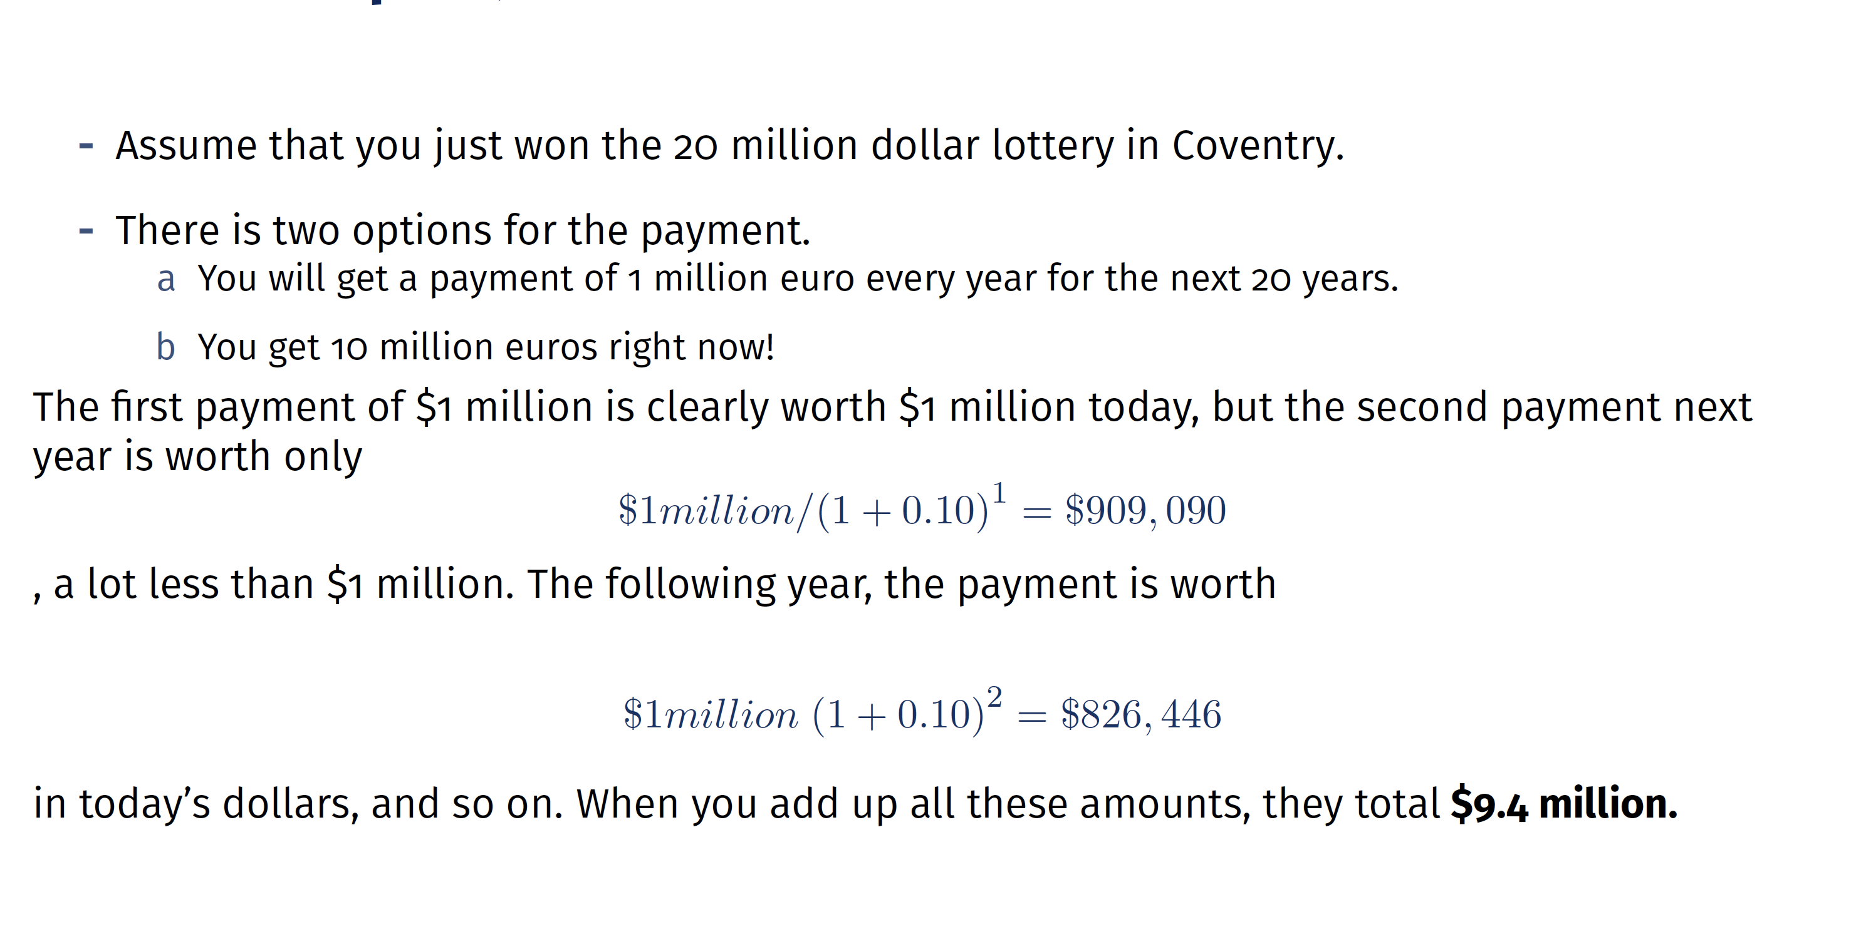

Slide 57
The Break!

Slide 58
The Only Game in Town:
Central Banking

Slide 59

The economic crisis
(the great recession of 2008)
has changed the world.

Slide 60

Central banks and bankers
became the central figures.

Slide 61
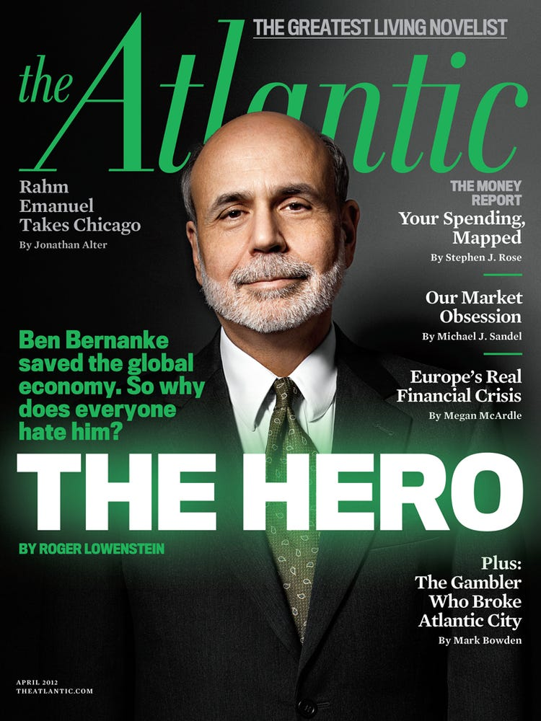
The new
and
most powerful
main
decision maker

Slide 62

The Fed
did not
rescue Lehman
but rescued
Bear Stearns and AIG. Why?

Slide 63

Their decisions
affect all of us,
but do they
have
a democratic
legitimacy?

Slide 64
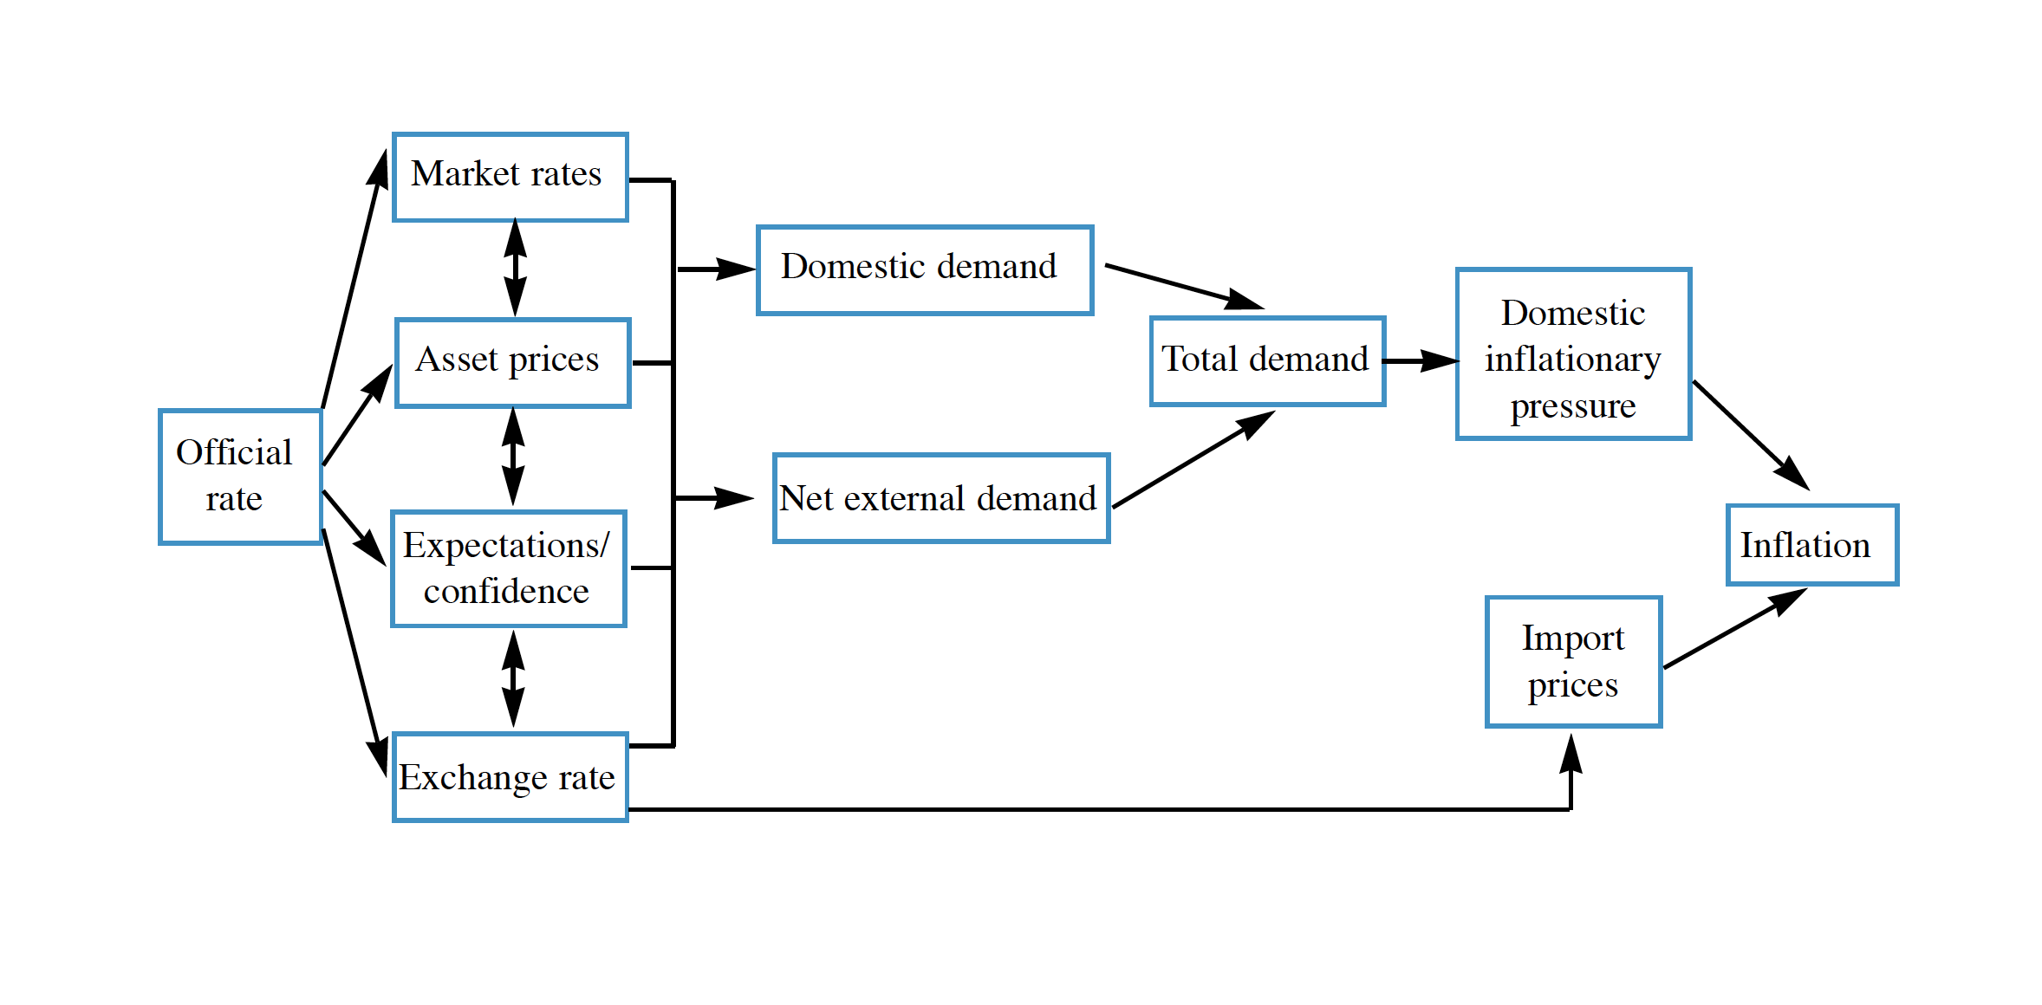

Slide 65
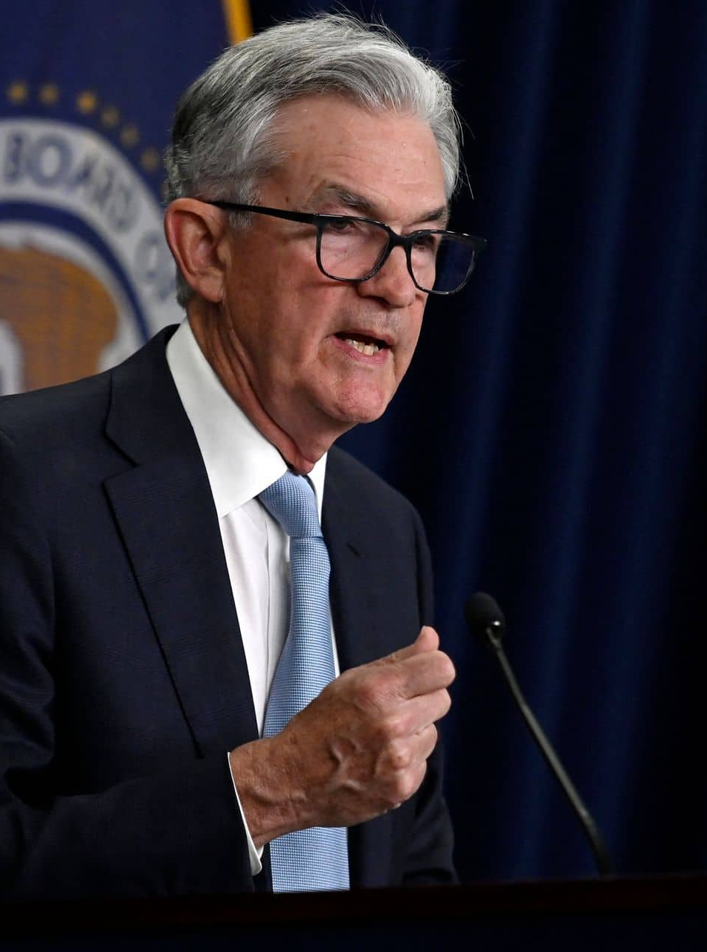
Central Banks
Monetary Policy: One of the primary functions of central banks is to formulate and implement monetary policy. They control the money supply, interest rates, and other monetary instruments to achieve specific macroeconomic objectives, such as price stability, low inflation, and sustainable economic growth.
Banker to Banks: Central banks serve as the "lender of last resort" to commercial banks, providing them with emergency liquidity during financial crises or when banks face liquidity shortages.
Maintaining Price Stability: One of the primary objectives of central banks is to maintain price stability by controlling inflation. They use various monetary policy tools to keep inflation within a target range.
Central Bank Independency and Democracy: An independent central bank can make monetary policy decisions based on economic fundamentals rather than short-term political considerations.
Central Bank Decisions Affect Our Lives: They affect our mortgages, the return on our savings, and the economy at large. When central bank adjusts its interest rates, it affects all of us, from Wall Street to Main Street."

Slide 66
The Break!

Slide 67
Financial Markets

Slide 68

Finansial Markets
1
Bond Markets
2
Futures Markets
3
Stock Markets

Slide 69
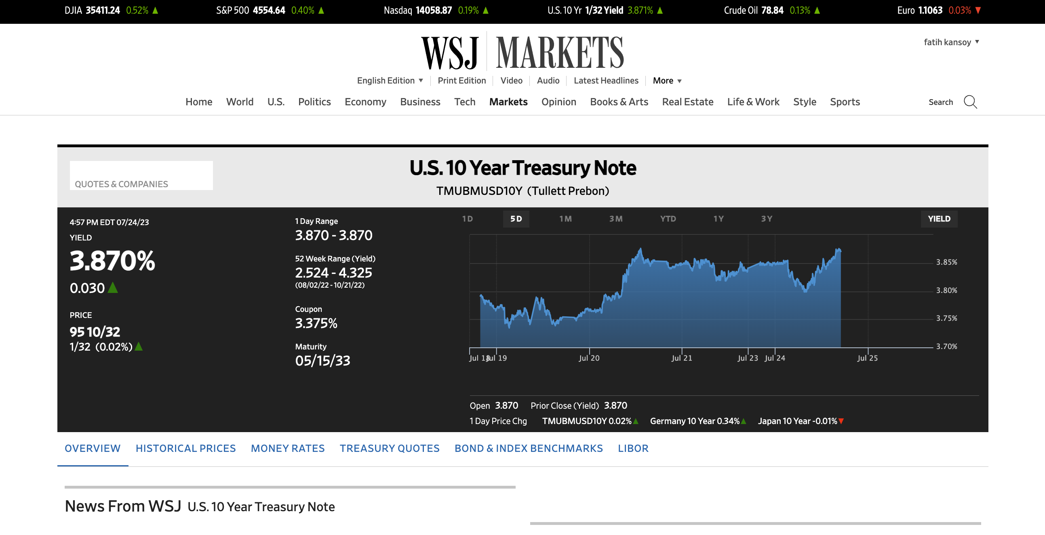

Slide 70
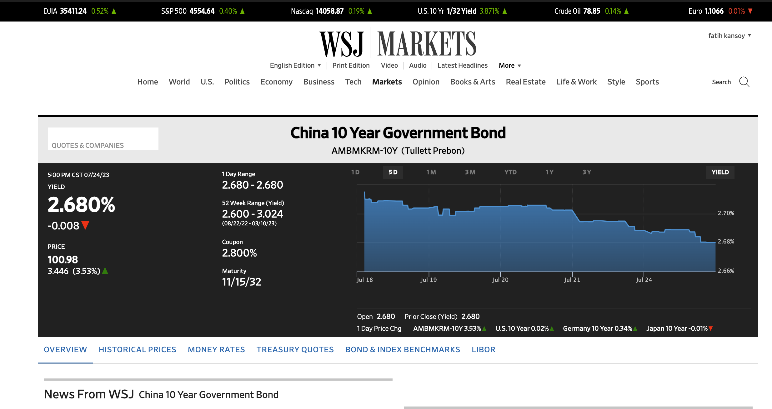

Slide 71
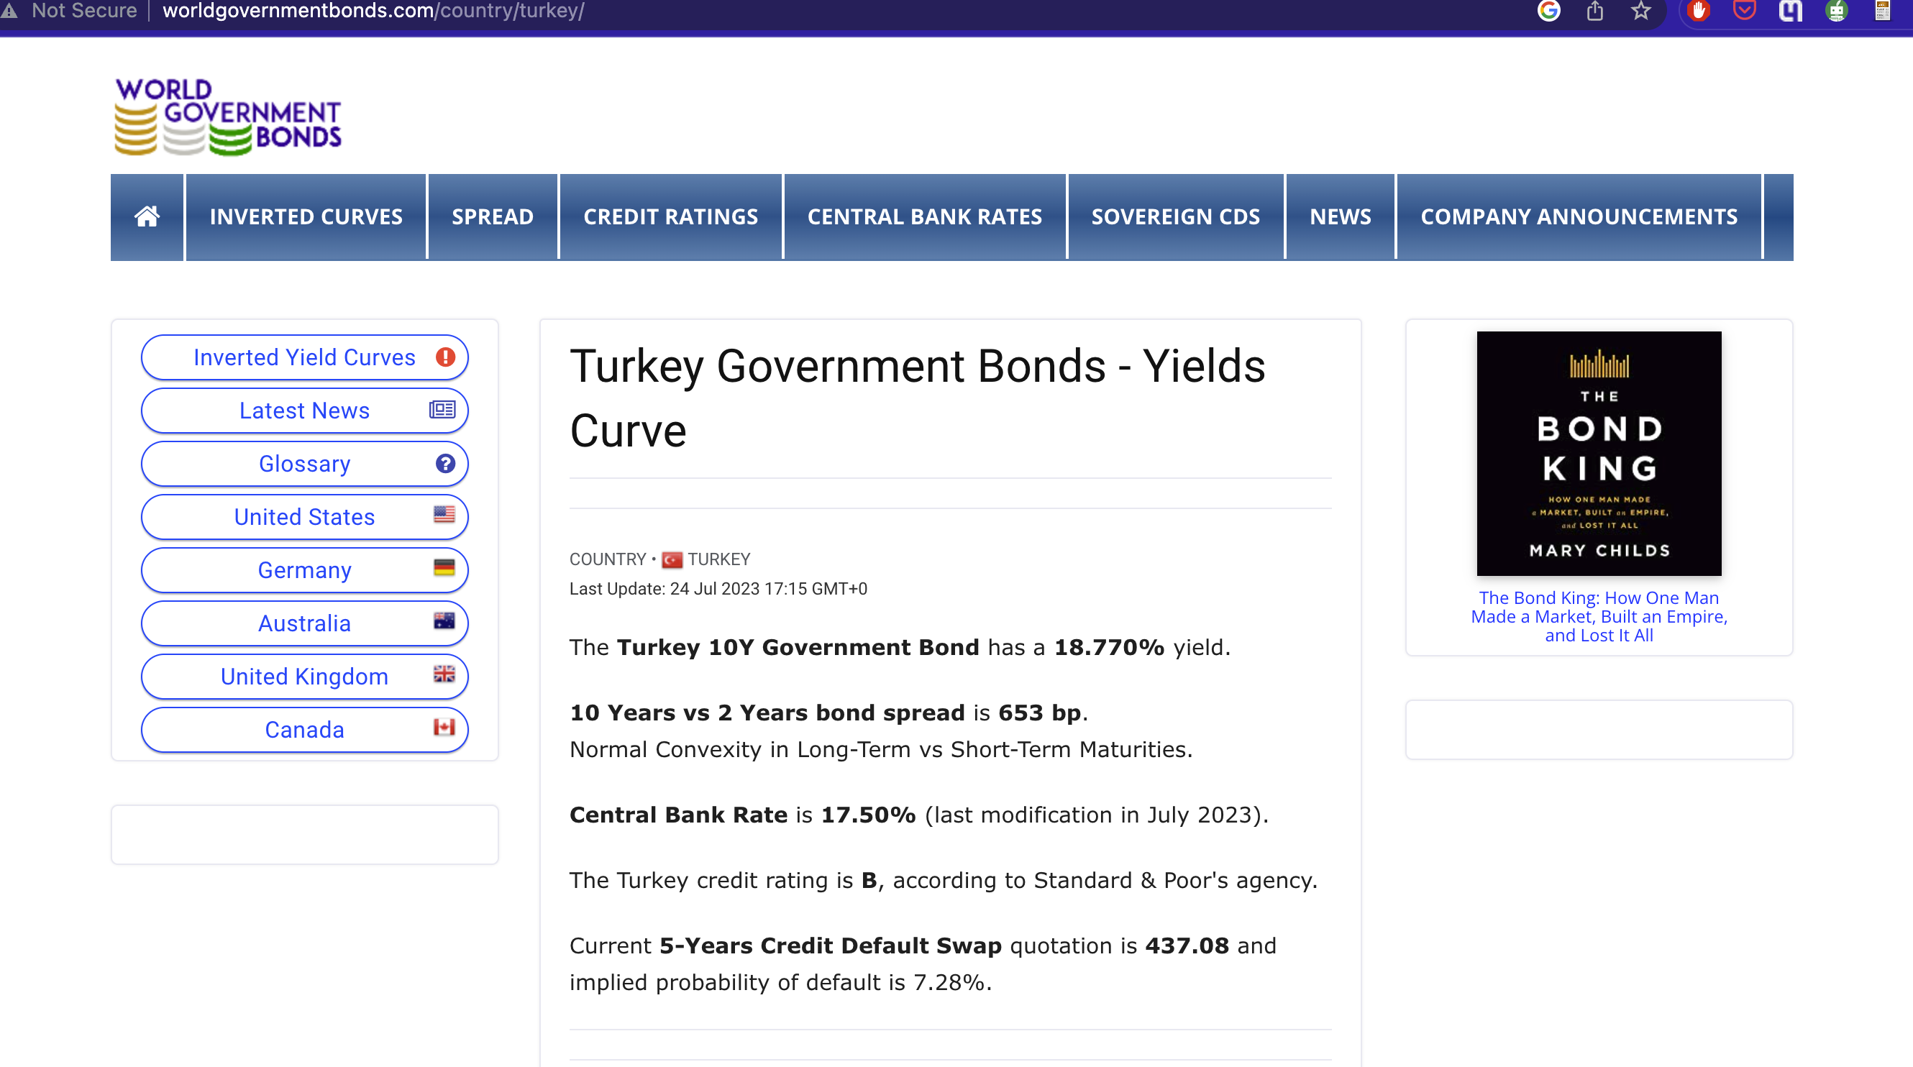

Slide 72
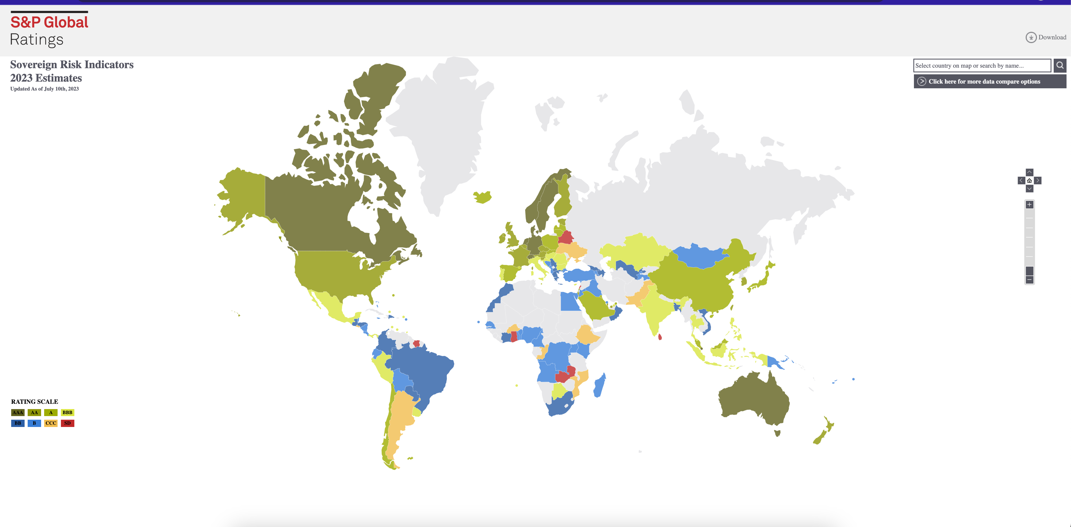
https://disclosure.spglobal.com/sri/

Slide 73
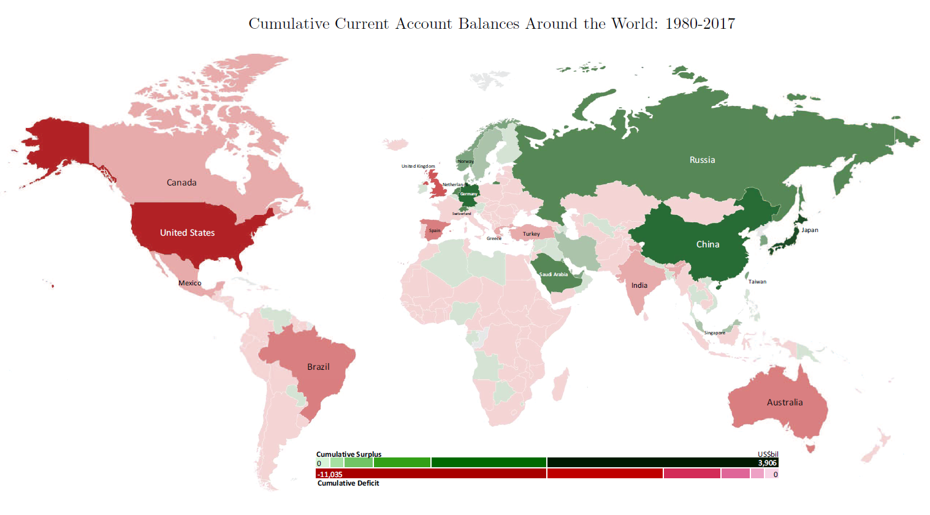

Slide 74
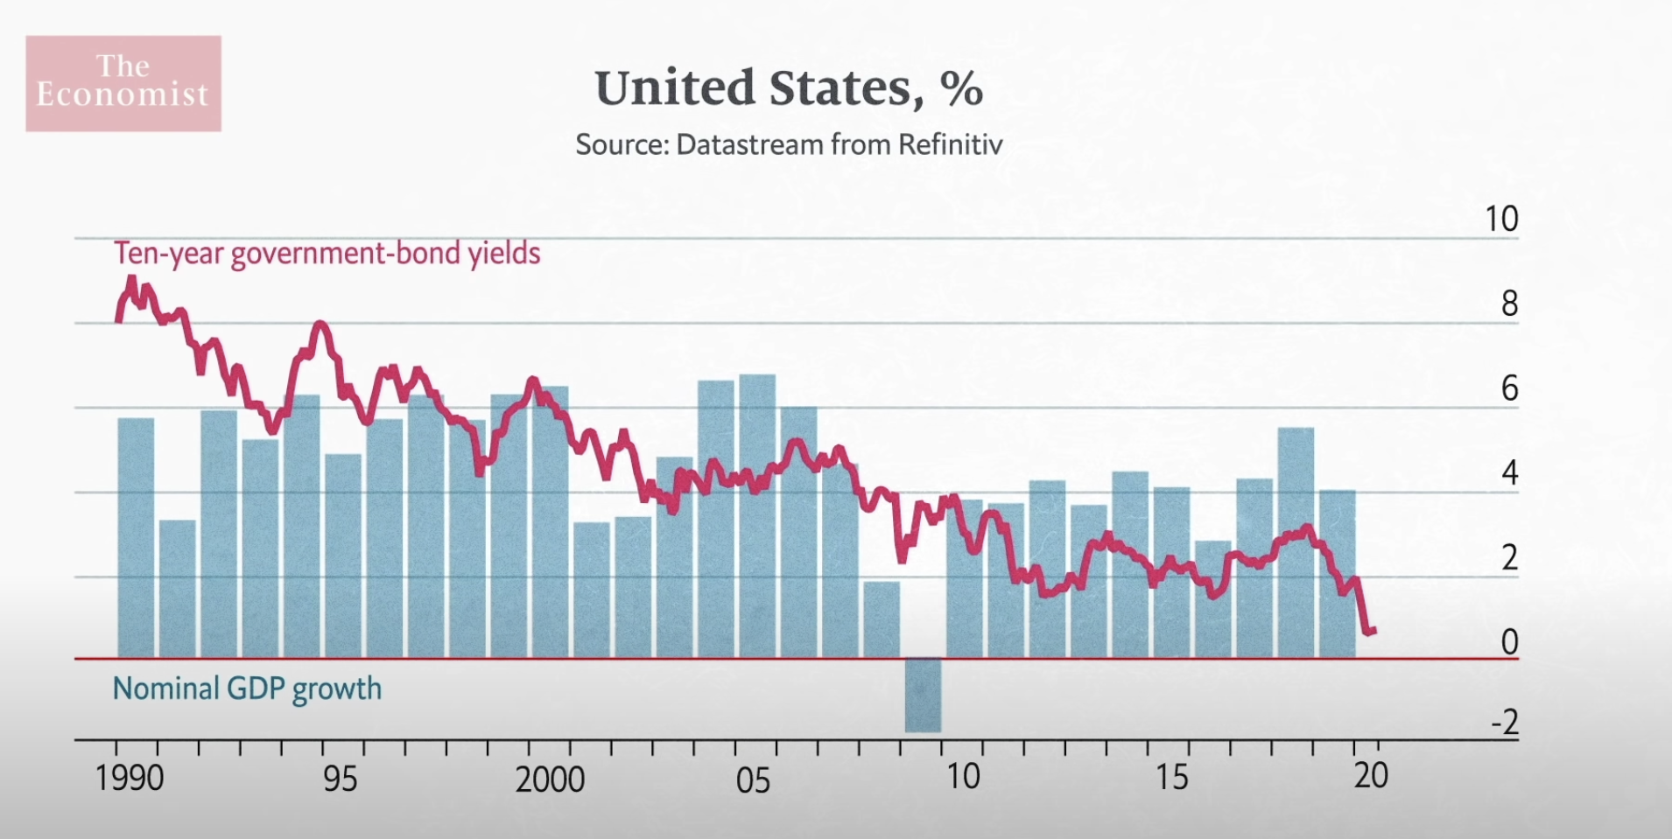
g > r

Slide 75
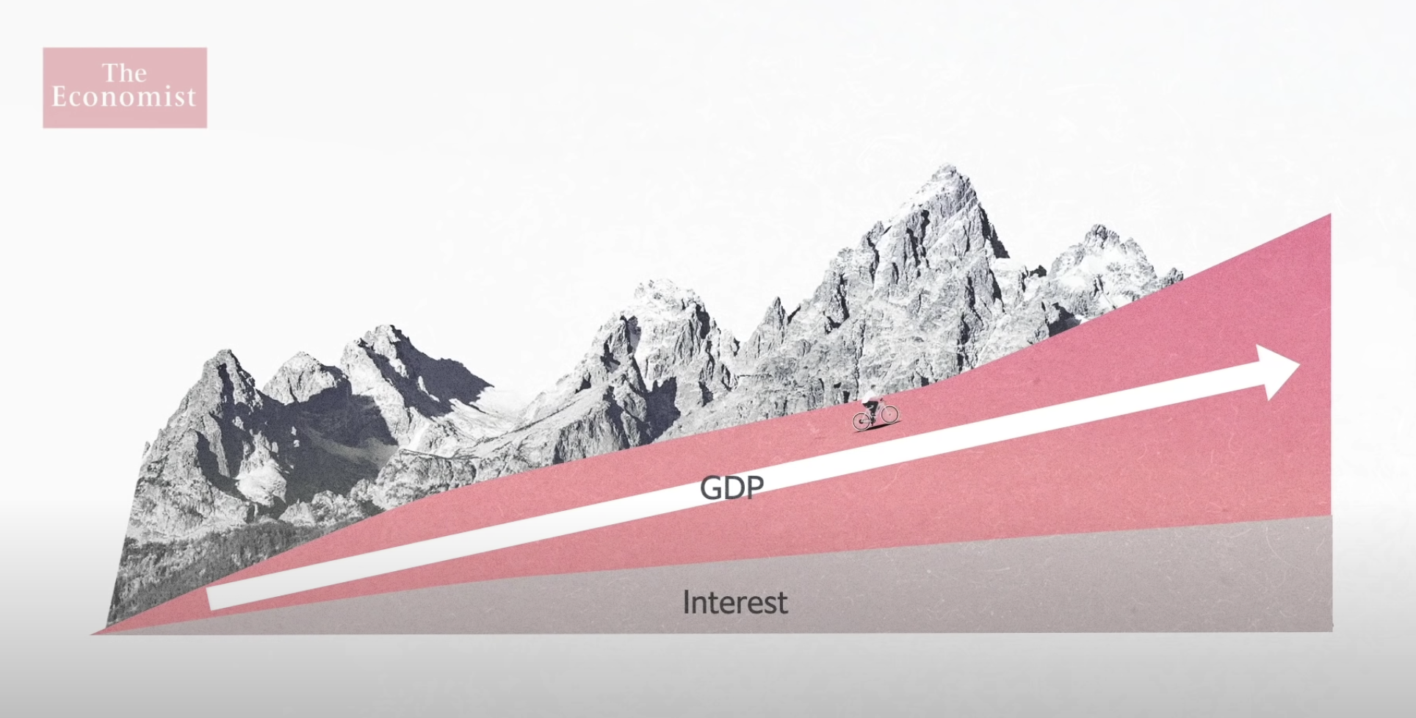
g > r

Slide 76
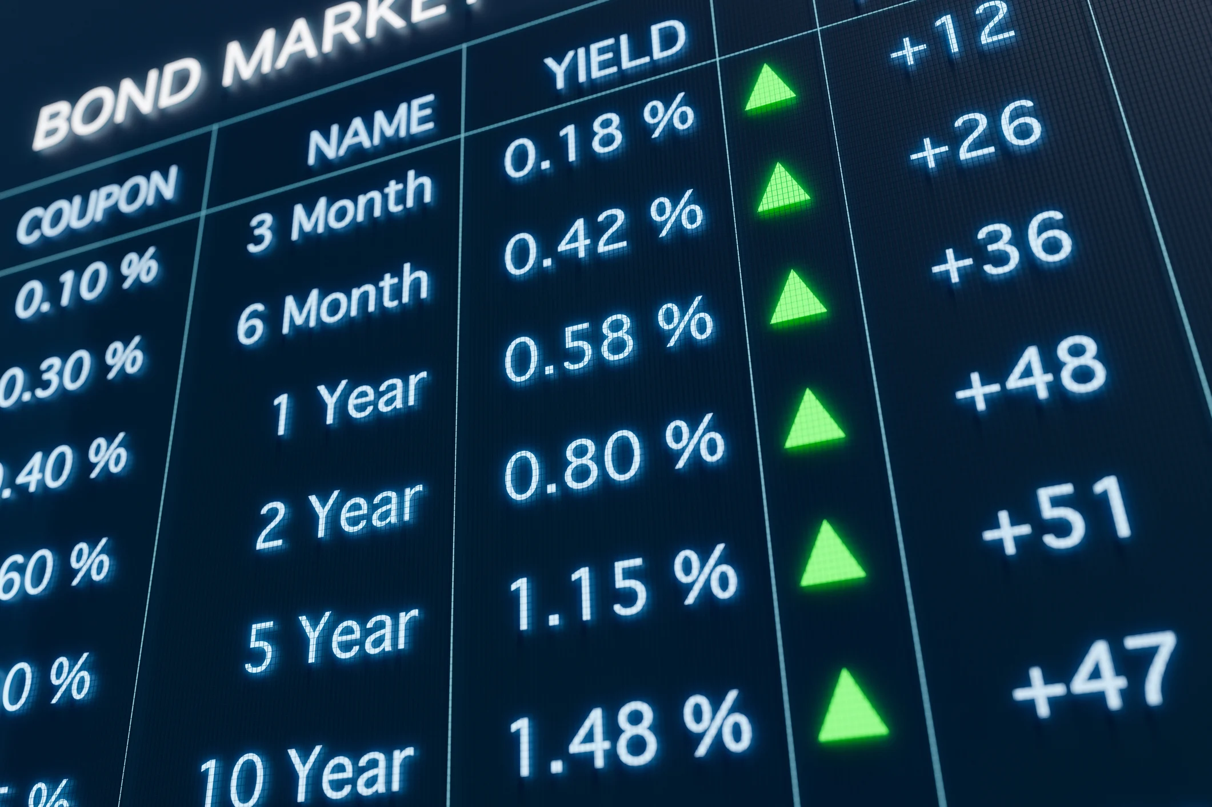
Bond Market
As of March 2023, the market capitalization of the bond market was estimated to be over $133 trillion. One of the largest financial markets.
It is a major source of funding for businesses and governments. Bonds are also a popular investment for individuals who are looking for a relatively safe investment with a fixed income stream.
The state of the economy: The 10-year bond yield is often seen as a leading indicator of economic growth. When the economy is growing, businesses tend to borrow more money, which increases the demand for bonds. This drives up the price of bonds, which lowers the yield.
The direction of interest rates: The 10-year bond yield is also seen as a proxy for future interest rates. When the 10-year bond yield goes up, it is a sign that investors expect interest rates to go up in the future.
The risk appetite of investors: The 10-year bond yield is also seen as a measure of the risk appetite of investors. When investors are feeling confident about the economy, they are more likely to invest in riskier assets, such as stocks. This drives down the demand for bonds, which lowers the yield.

Slide 77
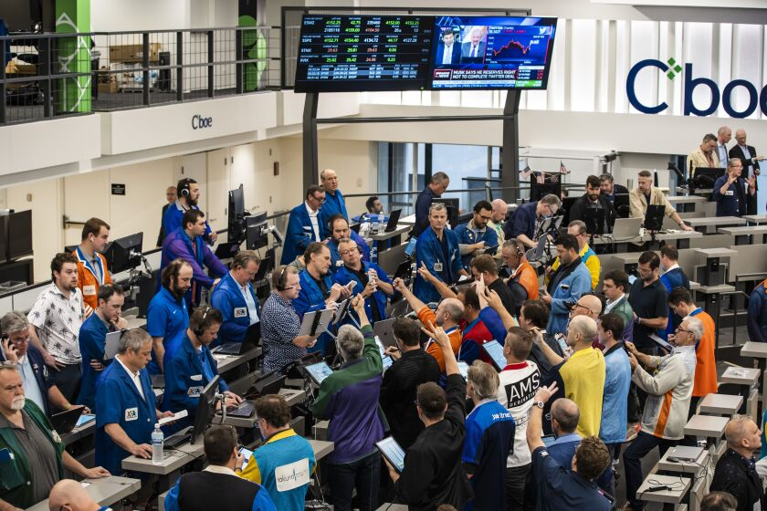
Futures Market
A futures contract is a standardized agreement to buy or sell an asset at a specified price on a specified date in the future. When you buy a futures contract, you are agreeing to buy the underlying asset at a specified price on a specified date in the future. The price of the futures contract is determined by supply and demand. If more people want to buy the asset than sell it, the price of the futures contract will go up.

Slide 78
Futures Market
The benefits of future markets: Futures contracts can be used to hedge against risk. Second, futures contracts can be used to speculate on future price movements.
They help in stabilizing prices, managing risk, and even guiding production decisions. Disruptions in this market can affect commodity prices, which can impact everything from your local grocery bill to geopolitical stability.
They facilitate price discovery. They reflect the collective wisdom of millions of traders about what the future price of a commodity or financial instrument will be.
The futures market is a global market. Futures contracts are traded on exchanges all over the world. The most active futures exchanges are the Chicago Mercantile Exchange (CME), the Chicago Board of Trade (CBOT), and the New York Mercantile Exchange (NYMEX)
The futures market is a complex market. There are many different types of futures contracts available, and the rules for trading futures contracts can vary from exchange to exchange.

Slide 79
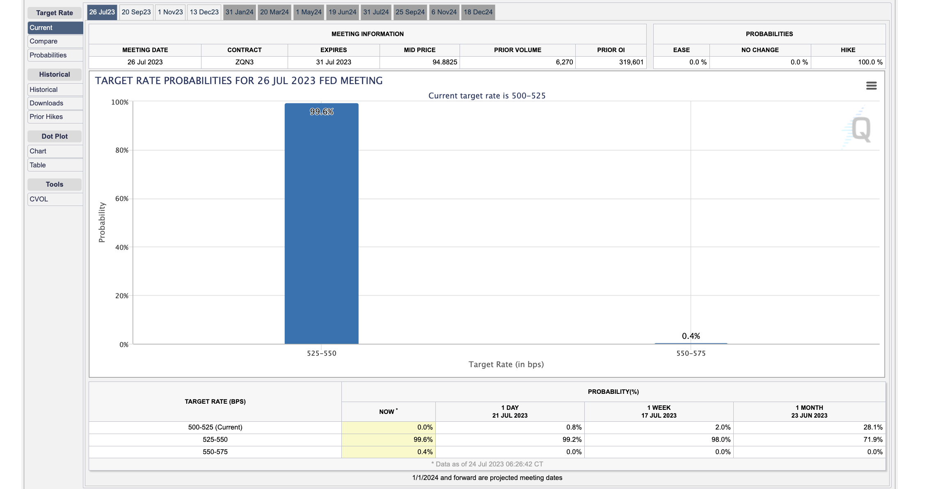

Slide 80
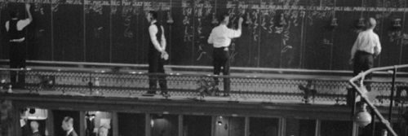
Stock Market
A stock market is a place where people can buy and sell shares of companies. Shares are a small piece of ownership in a company. When you buy a share of a company, you are essentially buying a piece of that company. Stock markets are important because they allow people to invest in companies and share in their growth. Stock markets also provide a way for companies to raise money. When a company issues shares, it is essentially selling a piece of itself to investors. This gives the company the money it needs to grow and expand.

Slide 81
Stock Markets
What does stock market movement/prices tell us? The movement of stock prices tells us a lot about the health of the economy and the investment climate. For example, if stock prices are rising, it means that investors are optimistic about the future of the economy.
The stock market is a vital platform where companies, big and small, raise capital for their operations and expansion. It enables companies to share a part of their ownership with the public in exchange for this capital.
This dynamic marketplace is also where countless individuals build their wealth. It's not just for Wall Street wizards but for everyday people planning for their retirement, saving for their children's education, or investing for personal goals.
Moreover, the stock market acts as a mirror, reflecting the overall health of a country's economy. Bullish markets often signify investor confidence and a growing economy, while bearish markets may suggest economic slowdown or looming crises.
Stock prices can also be affected by a variety of other factors, such as interest rates, inflation, and political events. For example, if interest rates rise, it will make it more expensive for companies to borrow money. This can lead to lower stock prices.

Slide 82
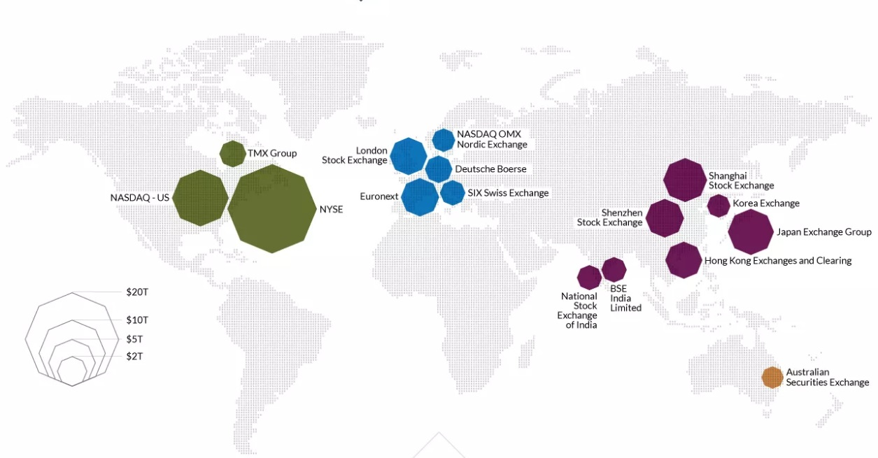
These 16 exchanges account for about 87% of total stock exchange market capitalization.

Slide 83
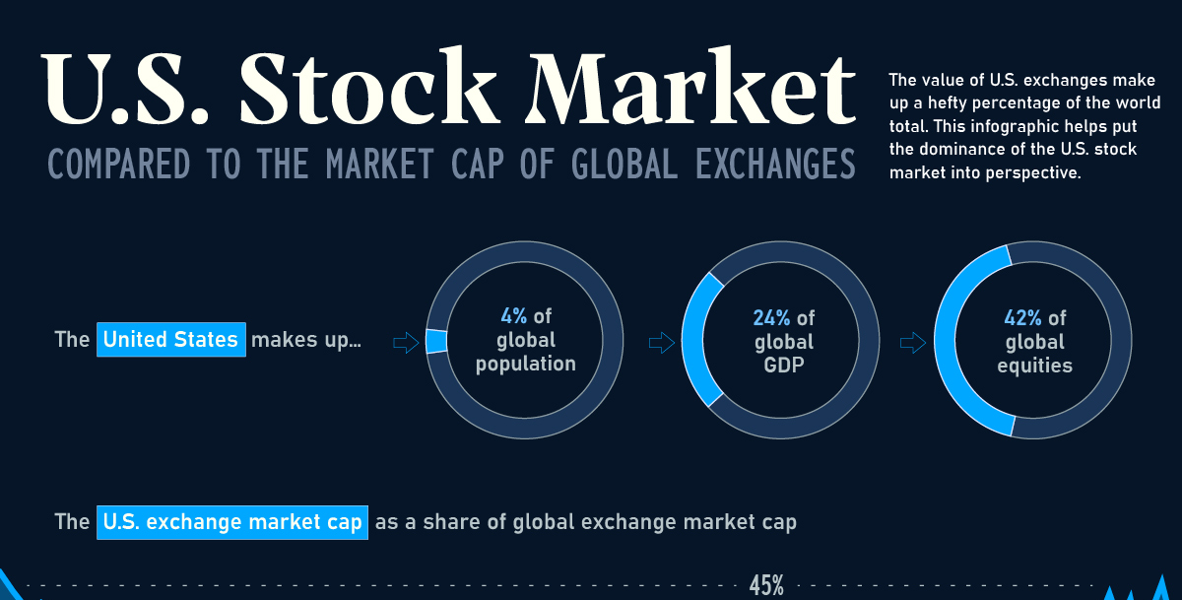

Slide 84

Finance
and
Climate Crisis

Slide 86
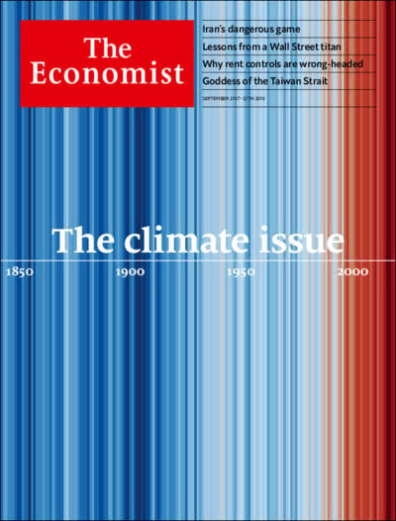


Slide 87
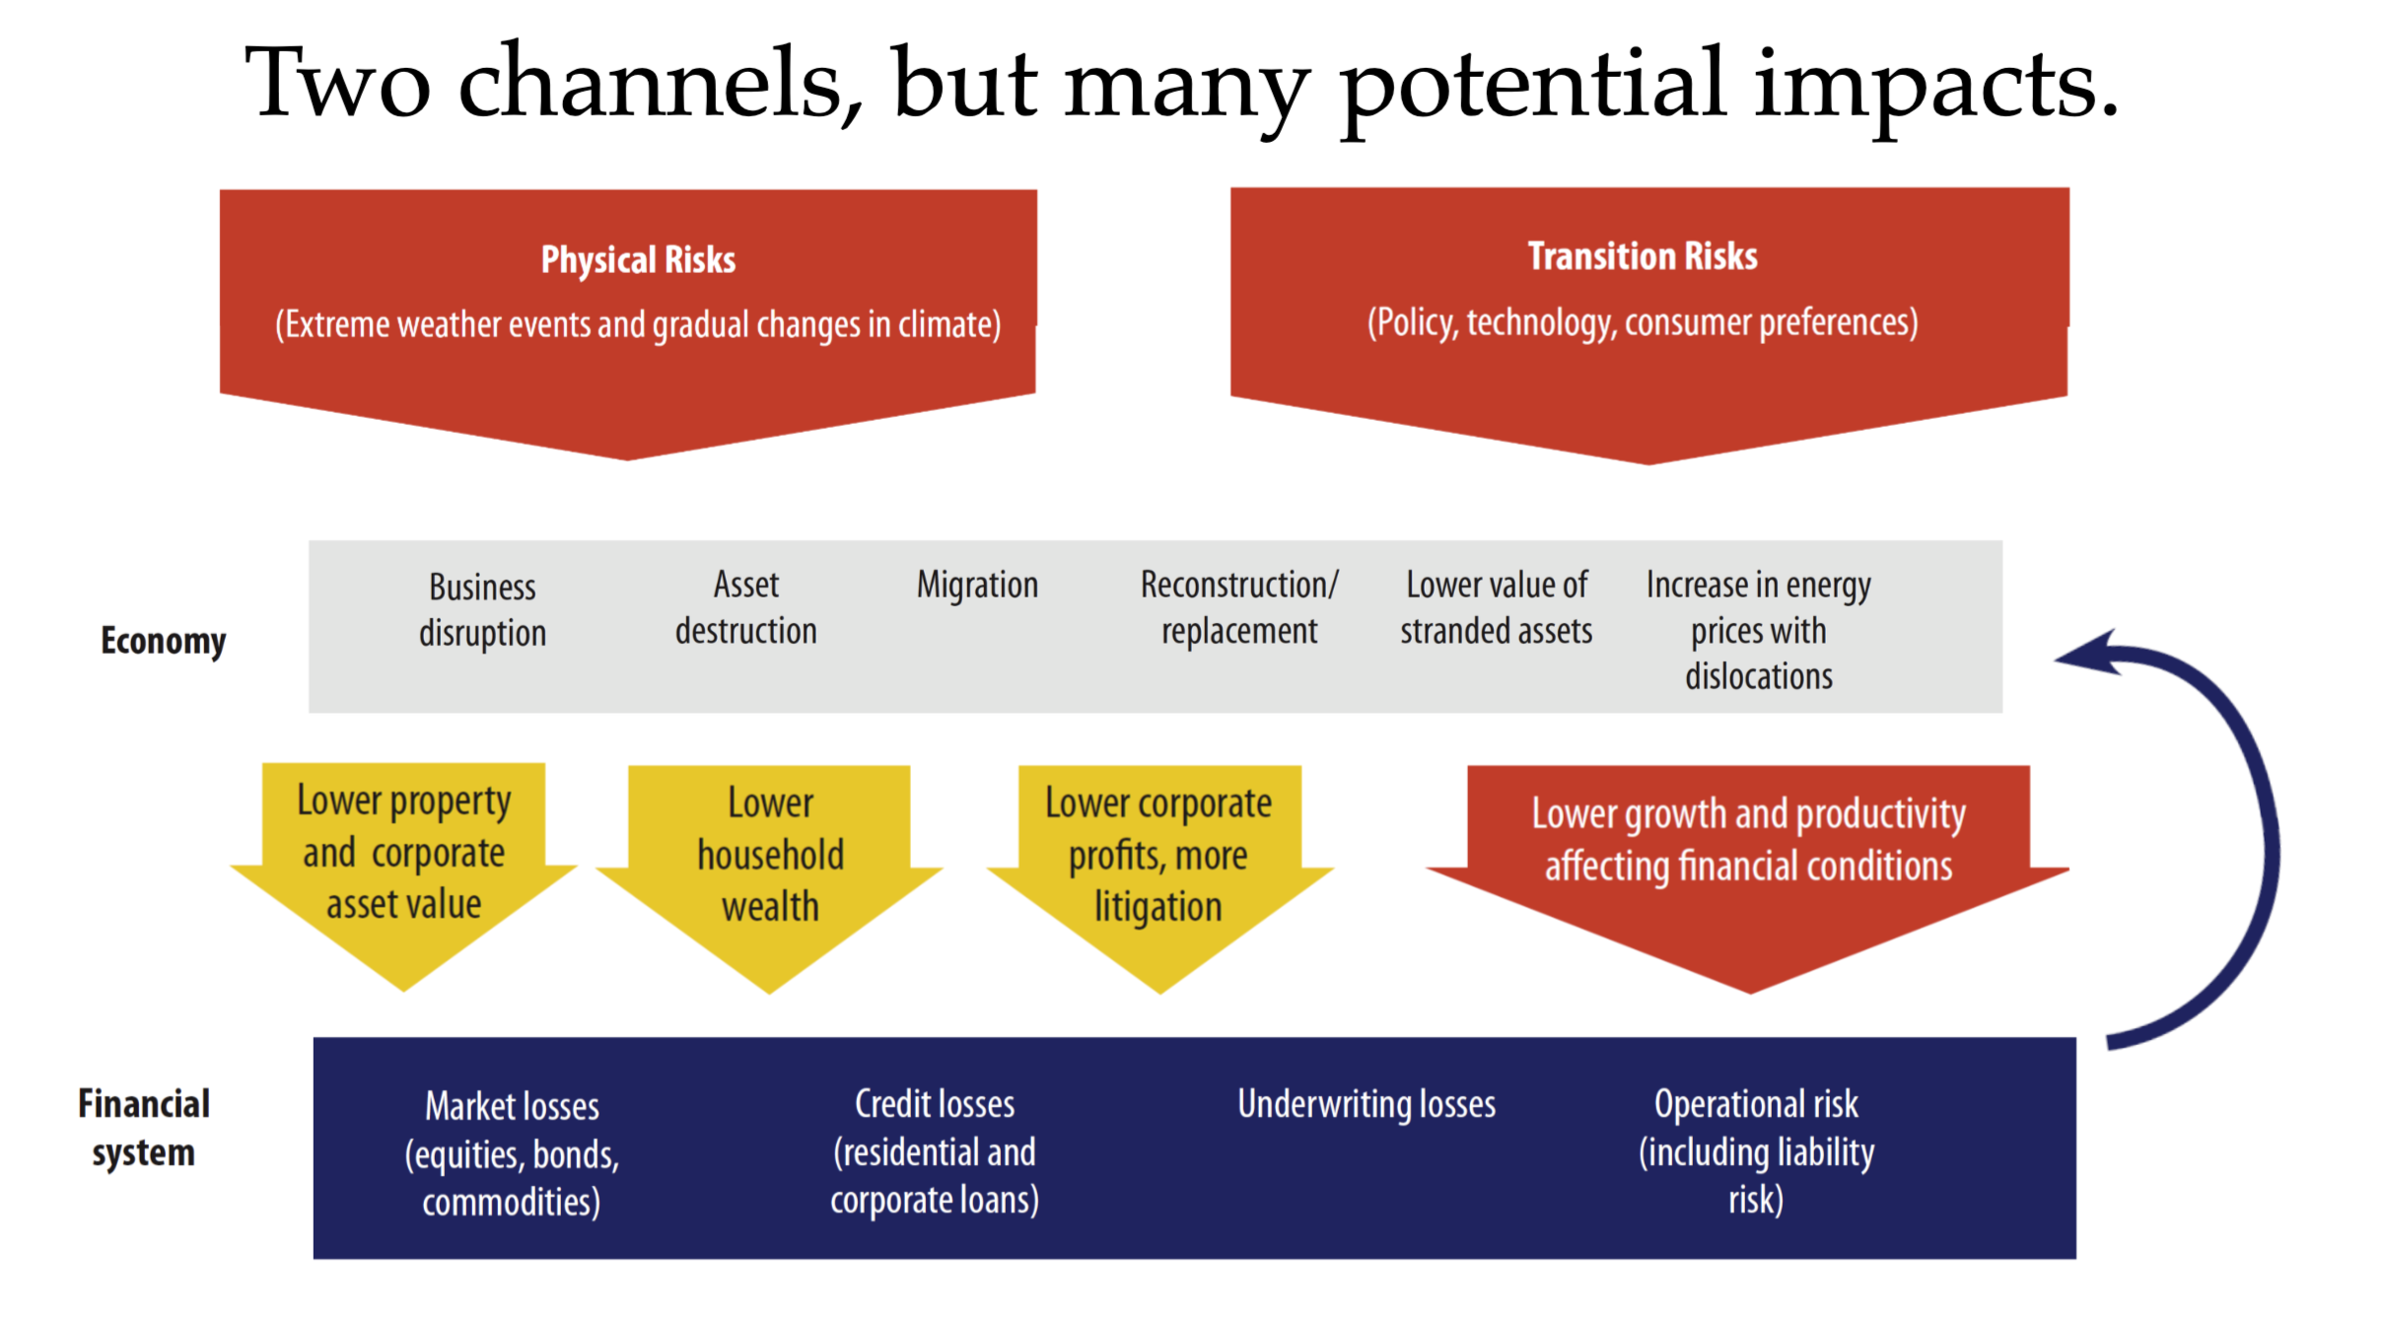

Slide 88
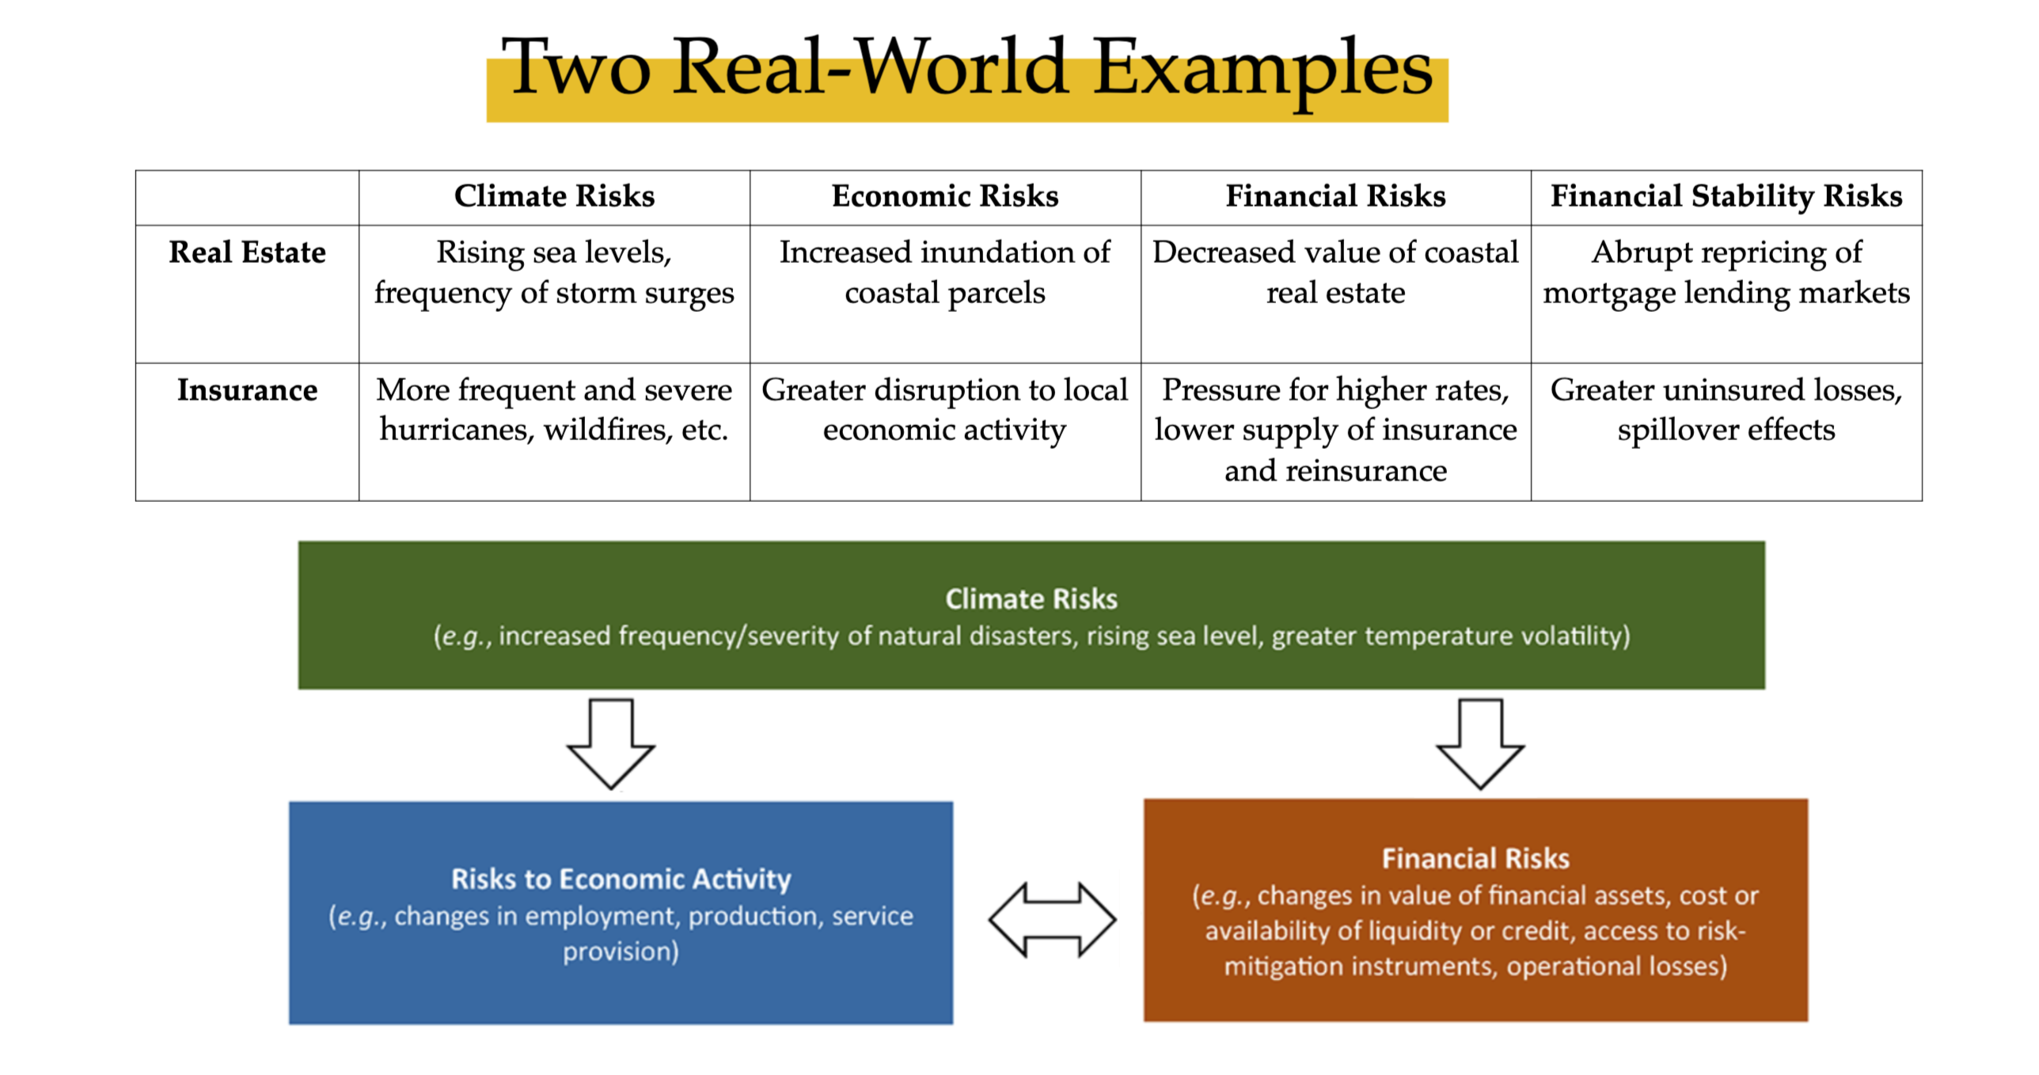

Slide 89
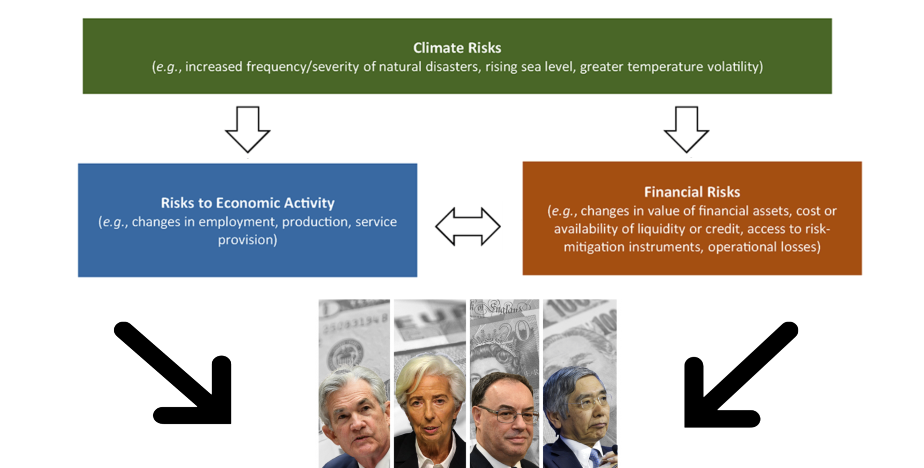

Slide 90
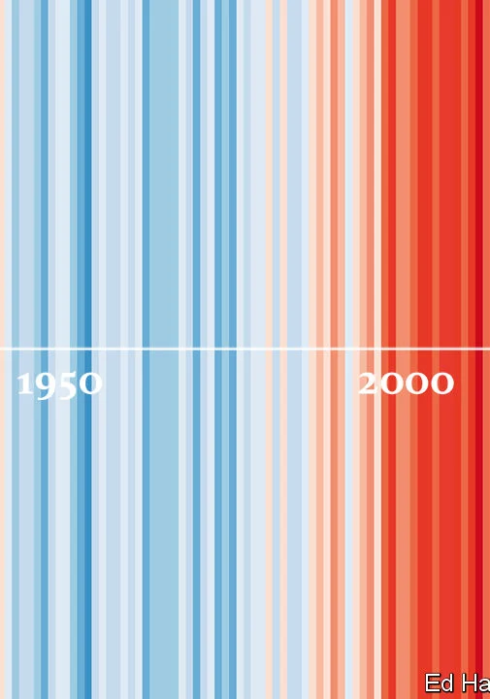
Central Bank: The Owner of Carrot-and-Stick
Offering loans at a below-market rate to support ‘environment businesses’ (B. of Japan)
Credit quota: Bank loans should be directed to environmental friendly sectors (Bangladesh)
Using Environmental, Social, and Corporate Governance (ESG) criteria for the government’s pension fund and excludes coal-based energy companies (The Norge Bank)
Green Quantitative Easing (ECB)

Slide 91
Data Revolution
and
Finance

Slide 92

Big Data and Finance
The data revolution is having a profound impact on finance. The vast amounts of data that are being generated by financial transactions, market movements, and other sources are being used to develop new products and services, improve risk management, and make better investment decisions
Credit scoring: Big data is being used to develop new credit scoring models that are more accurate than traditional credit scoring models. These new models can take into account a wider range of factors, such as social media activity and internet browsing history, to provide a more comprehensive assessment of a borrower's creditworthiness.
Fraud detection: Big data is being used to develop new fraud detection systems that can help to protect financial institutions from fraud. These systems can analyze large amounts of data to identify patterns that may indicate fraudulent activity.
Market monitoring: Big data is being used to monitor financial markets for signs of instability. These systems can track trading patterns, social media sentiment, and other data to identify potential risks.
Early warning systems: Big data is being used to develop early warning systems that can help to prevent financial crises. These systems can track economic indicators, financial market data, and other data to identify potential problems early on.

Slide 93

Algorithmic Trade
In today's fast-paced financial world, algorithmic trading is a game-changer. In 2020, it was estimated that 85% of all trading in the forex markets was performed by algorithms rather than humans.
Algorithmic trading has a number of benefits. It can help to improve trading efficiency by automating trading decisions. It can also help to improve profitability by identifying trading opportunities that would otherwise be missed.
Growth of the financial markets: The growth of the financial markets is creating new opportunities for algorithmic trading. As the markets become more complex, algorithmic trading can help traders to stay ahead of the curve.
However, algorithmic trading also has some risks. One risk is that algorithmic traders can amplify market volatility. Another risk is that algorithmic traders can be vulnerable to cyberattacks.
In terms of monetary policy, these technologies can offer central banks more granular, high-frequency data that can enhance their decision-making process. Yet, the increasing use of algorithms and AI in finance could also affect how monetary policy is transmitted through the financial system.

Slide 94
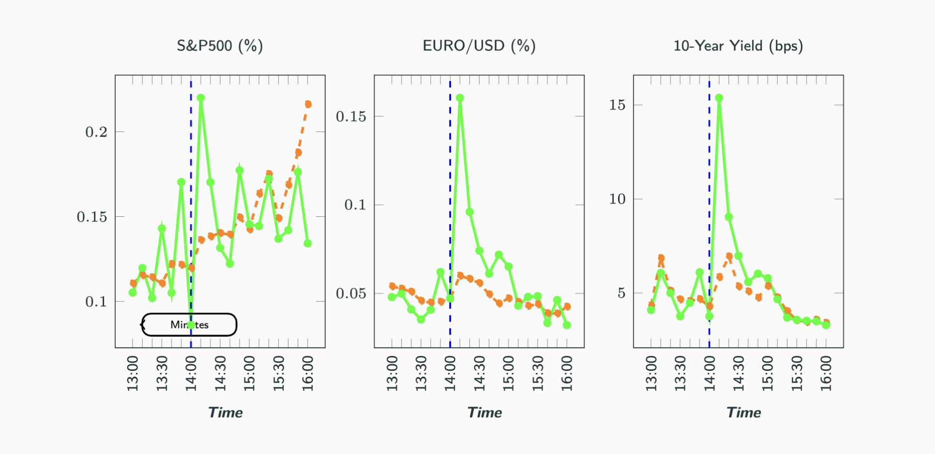
High-Frequency Data

Slide 95
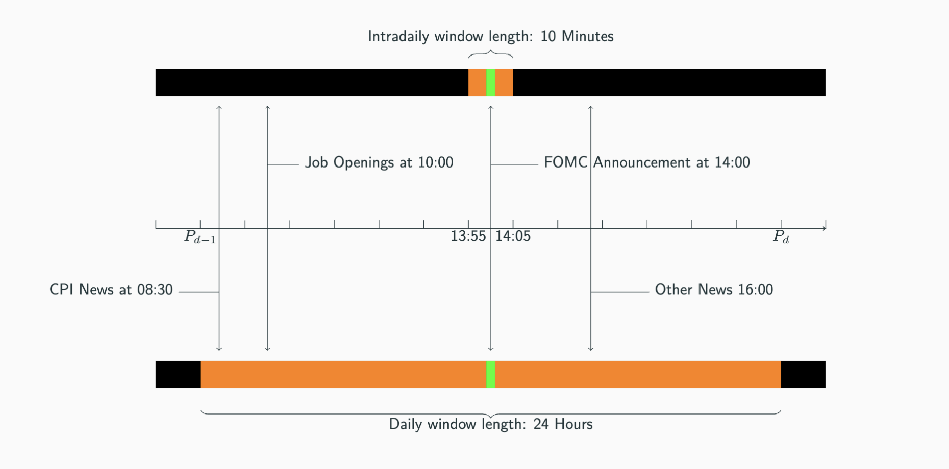
High-Frequency Data

Slide 96
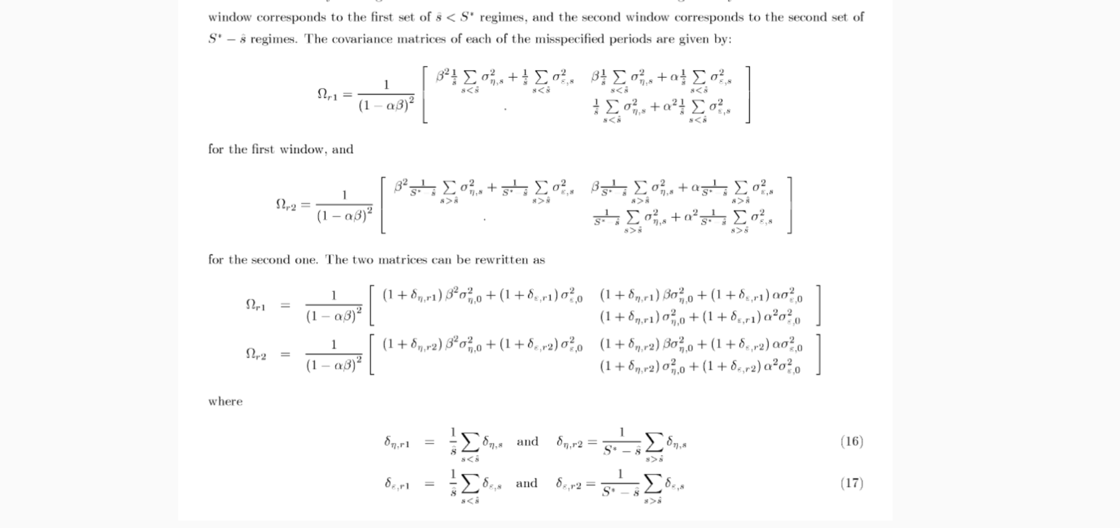
High-Frequency Data

Slide 97
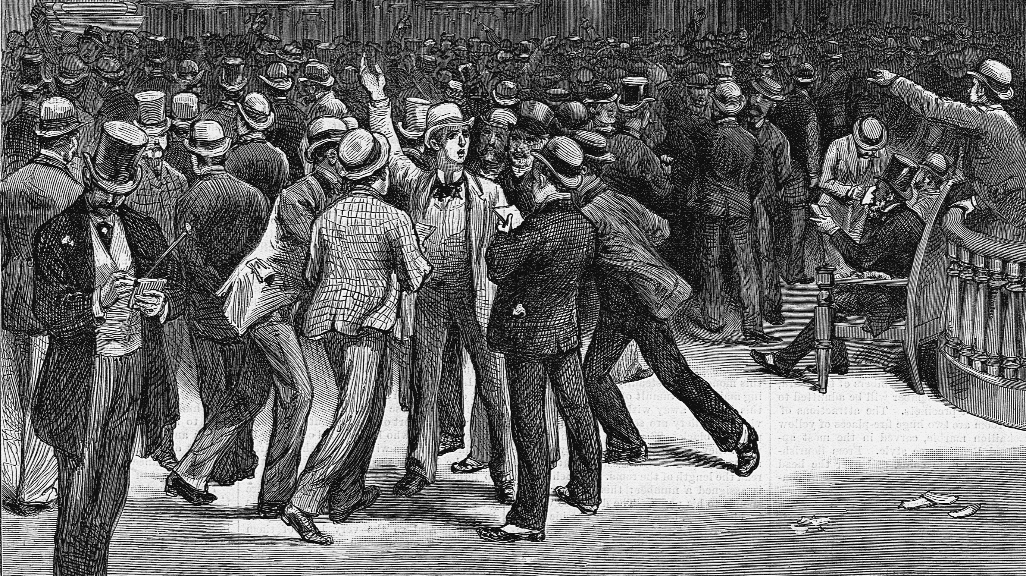

Slide 98


Slide 99
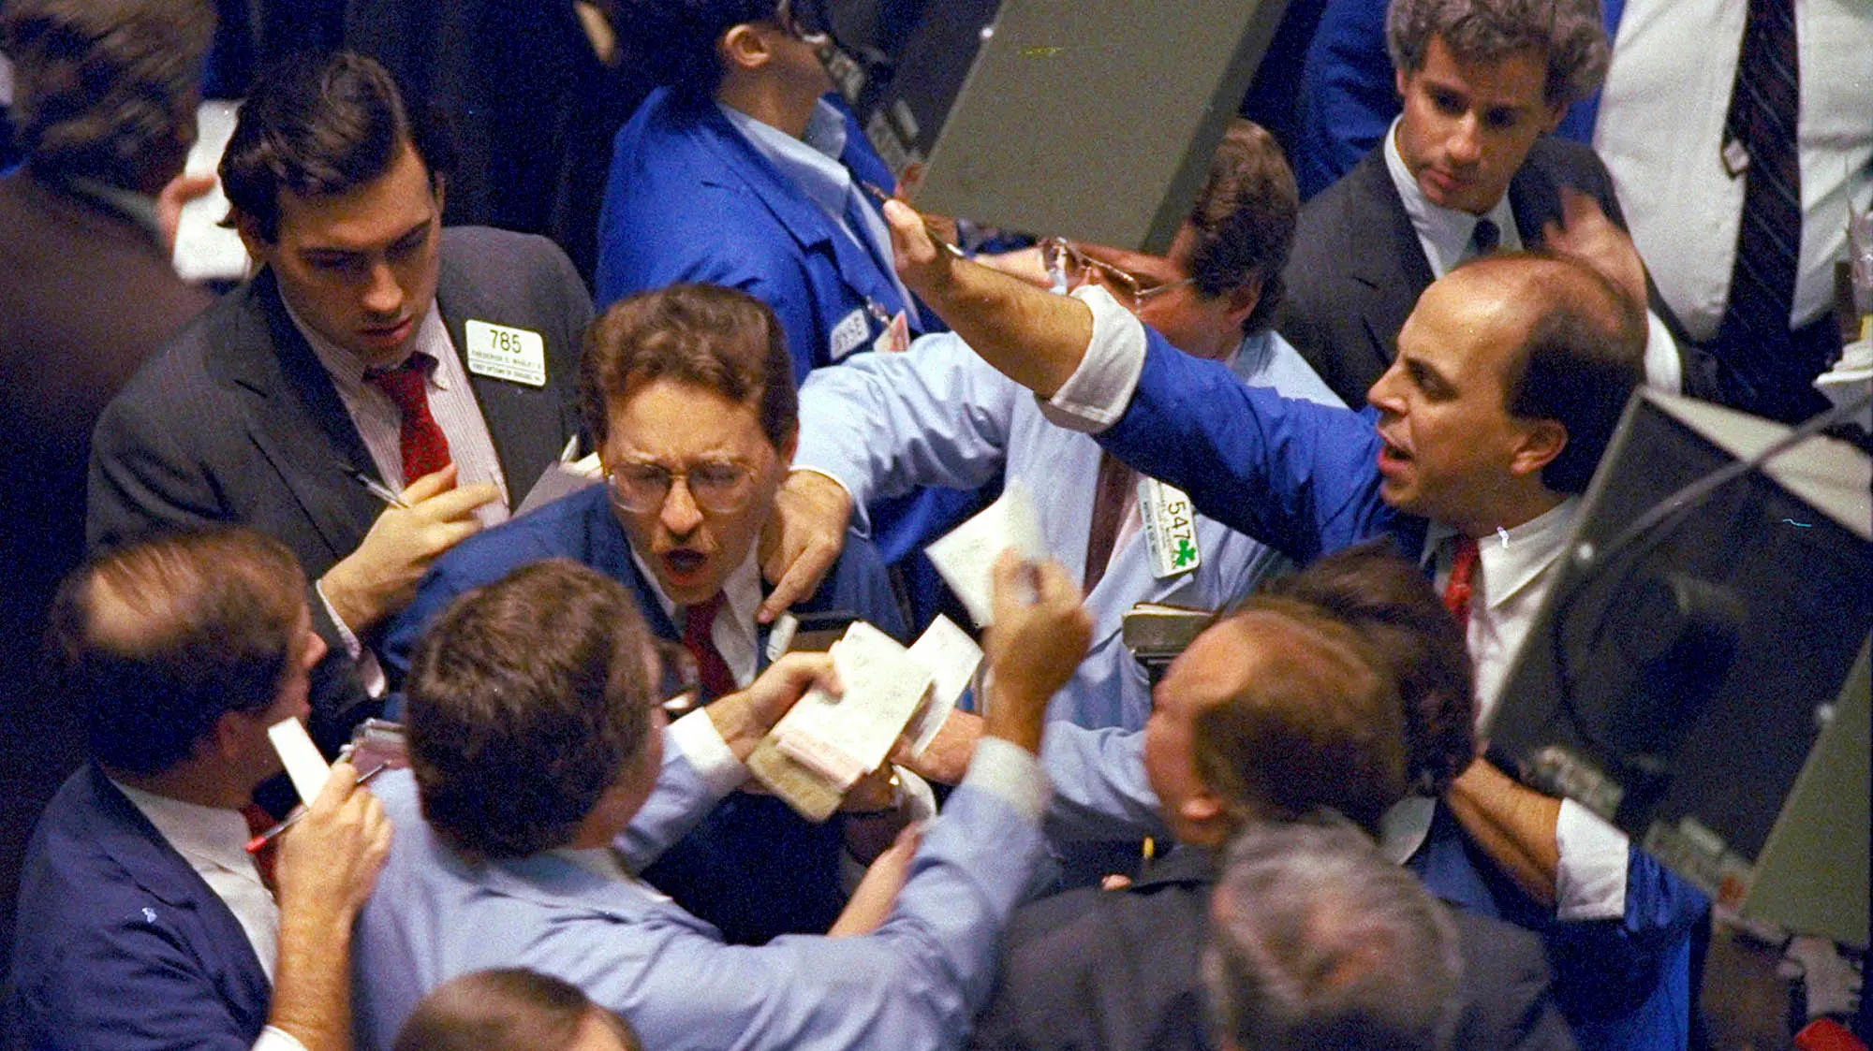

Slide 100


Slide 101


Slide 102
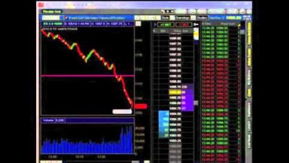

Slide 103
THANK YOU

